Slide 1
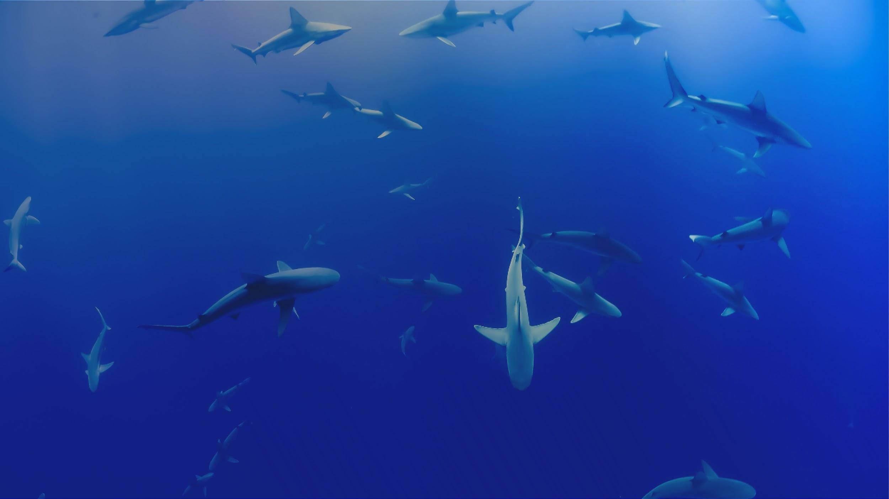


OBIS Training – Winter 2021
Jon Pye, Brian Jones, Naomi Tress
Ocean Tracking Network Data Centre

Slide 2
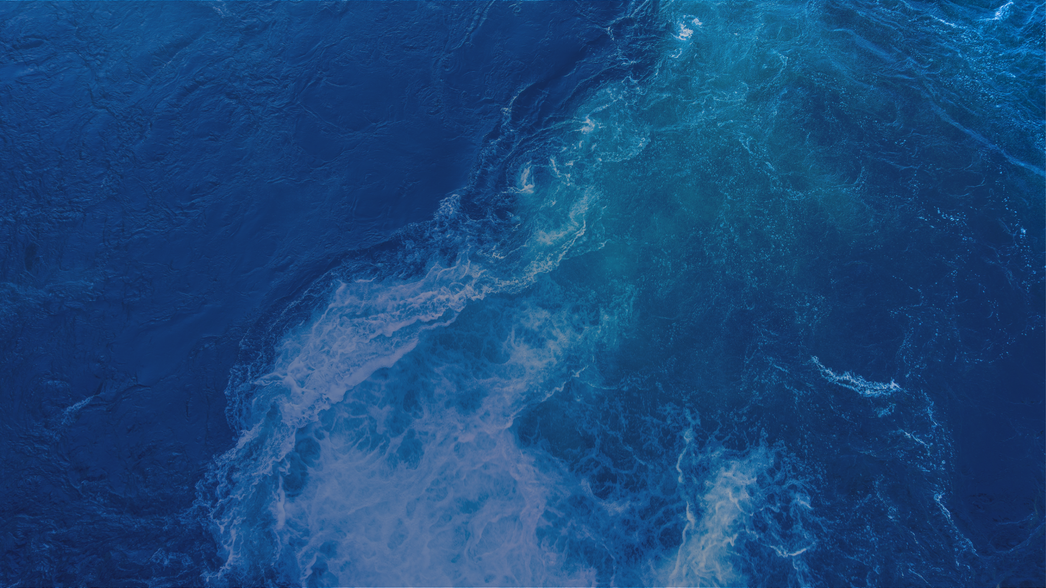

ABOUT OTN
Global aquatic research, data management and partnership platform headquartered at Dalhousie University in Nova Scotia, Canada.
Since 2008, OTN has been deploying state-of-the-art ocean monitoring equipment and marine autonomous vehicles (gliders) in key aquatic locations.
OTN has established partnerships with a global community of stakeholders to document the movements and survival of aquatic animals in the context of changing ocean environments.
Knowledge generated by OTN is used by scientists, managers, policy-makers, industry, Indigenous and coastal communities and the general public.
OCEAN TRACKING NETWORK
Notes:
First, a bit about who we are. The Ocean Tracking Network is an aquatic research, data management, and partnership platform at Dalhousie University. We focus on biologging and electronic means of determining animal presence, especially acoustic telemetry. We partner with many stakeholders to make sure that data collected by researchers is used optimally and becomes part of the knowledge base used by decision makers, coastal communities, and the public at large.

Slide 3
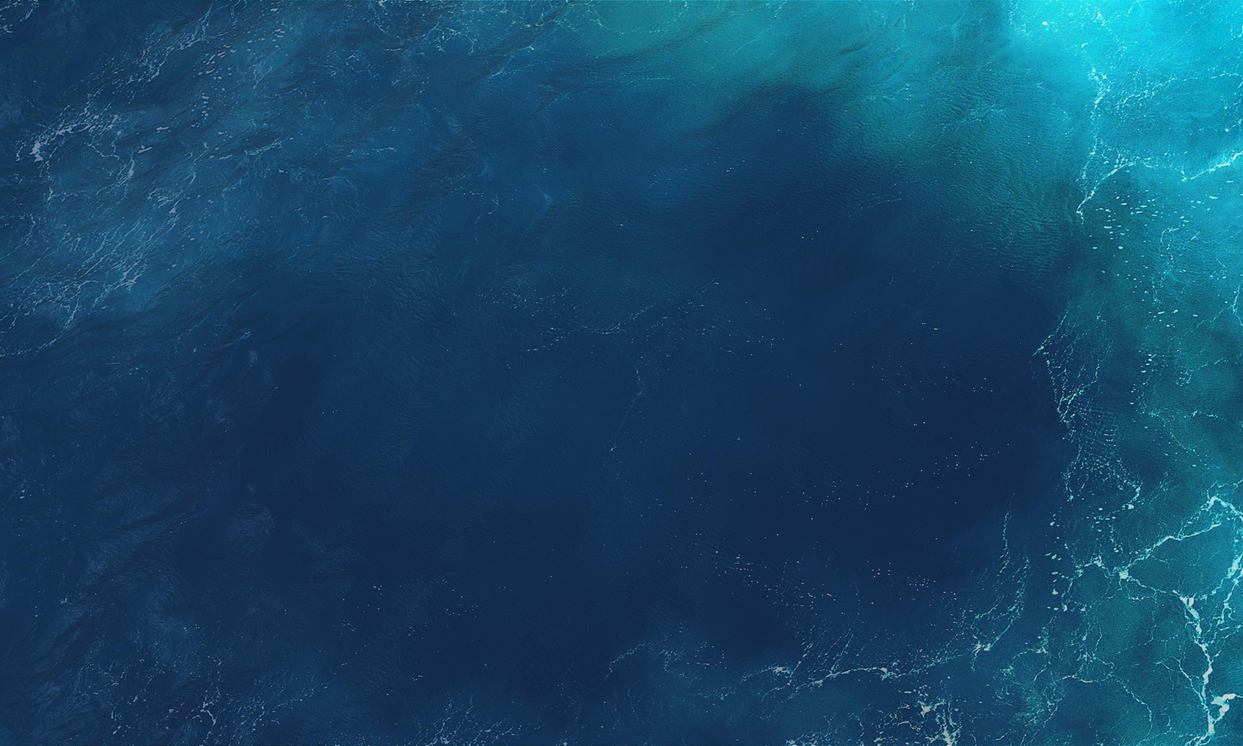
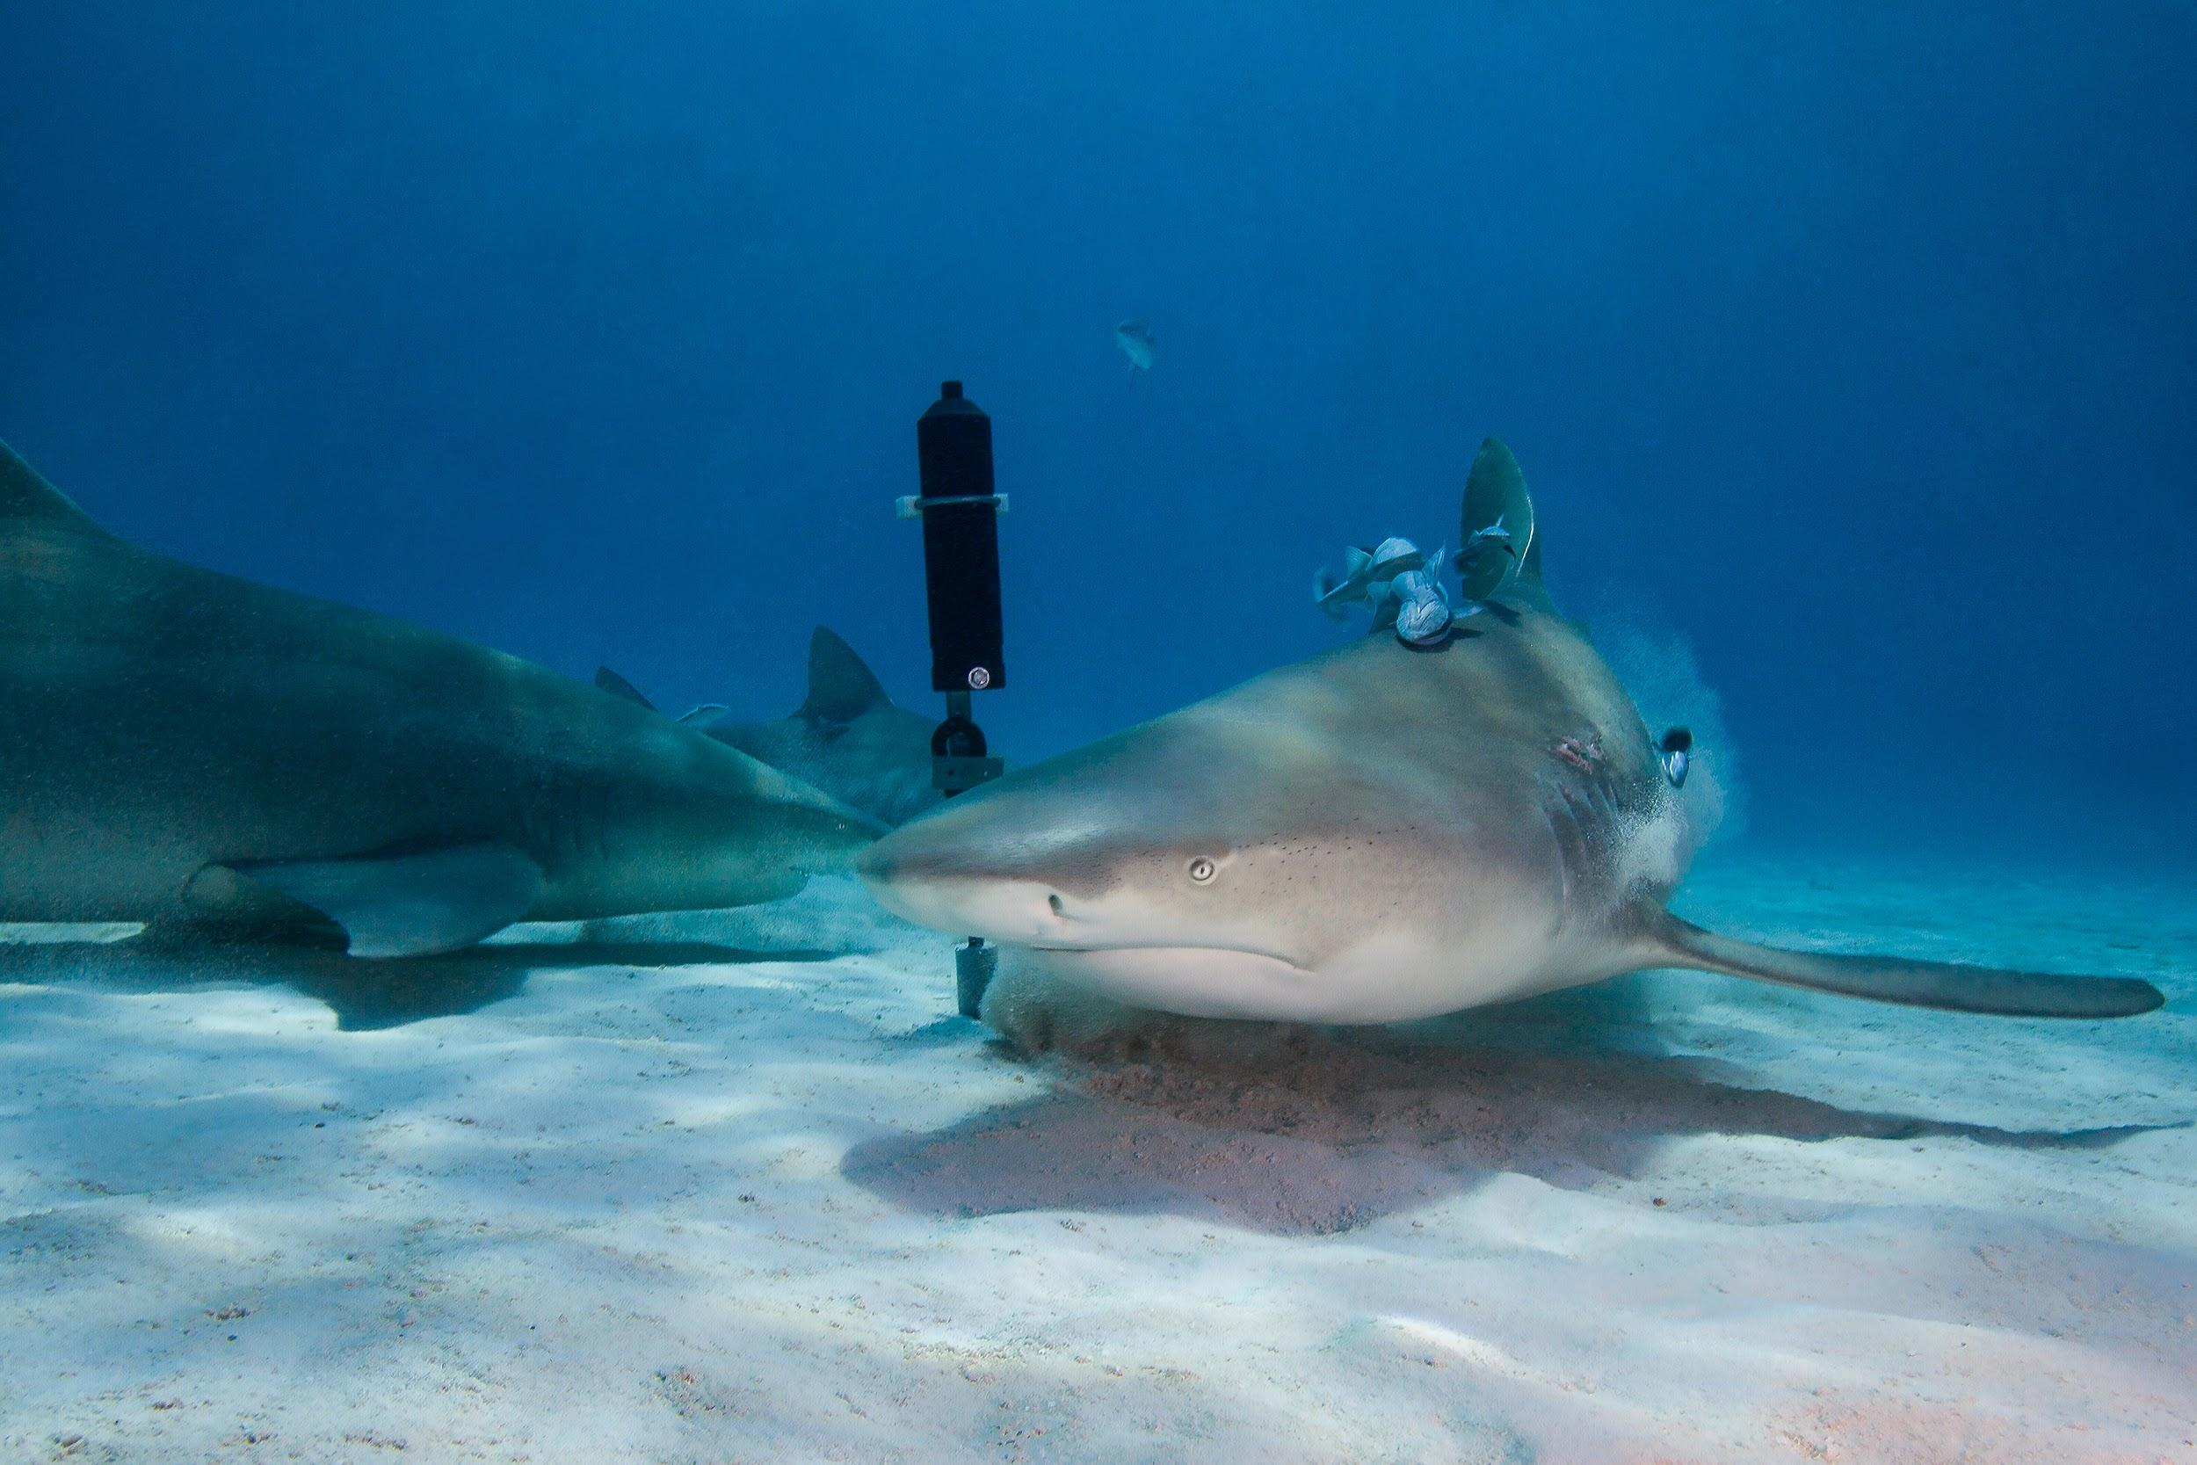
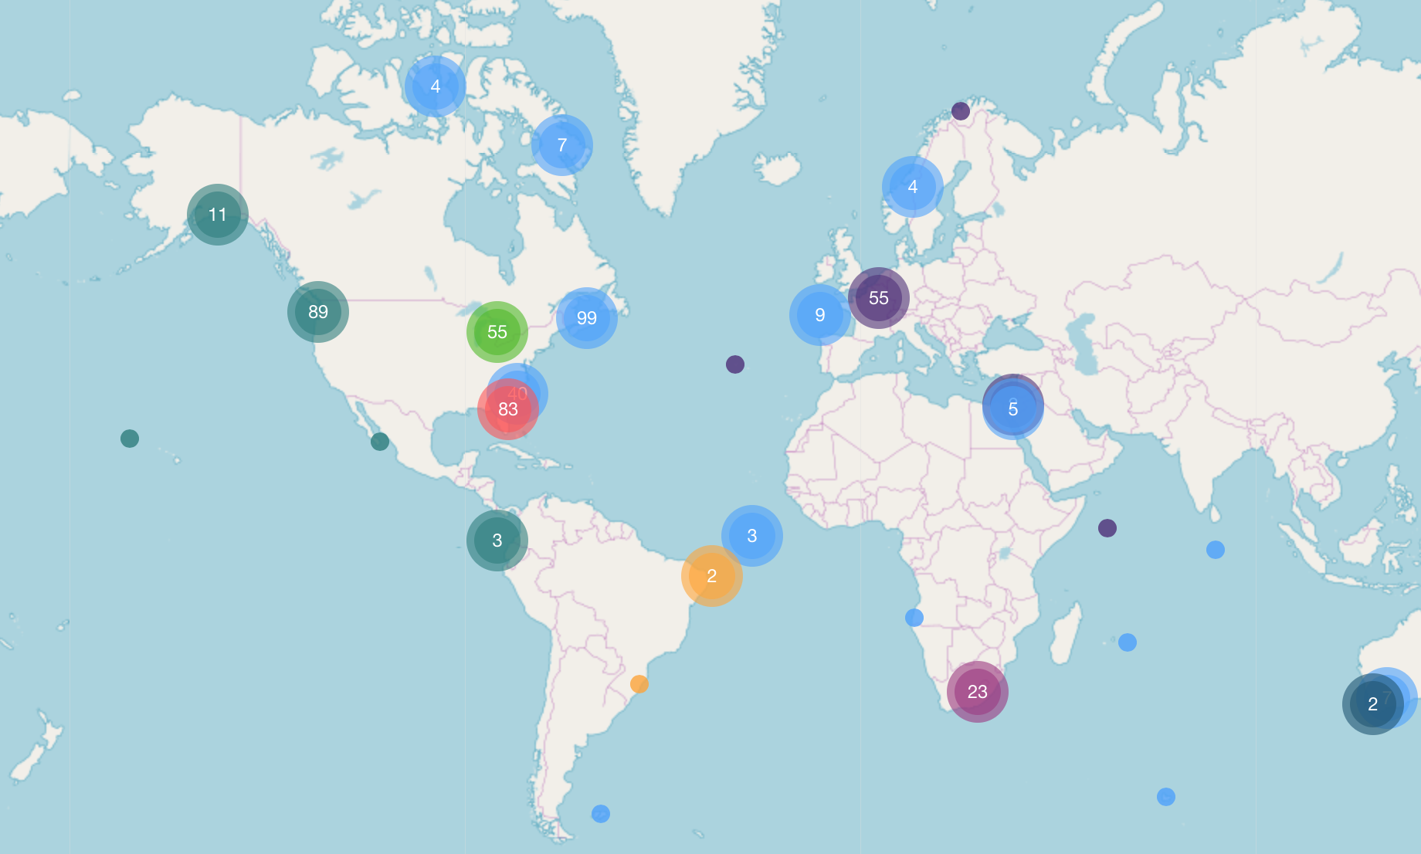
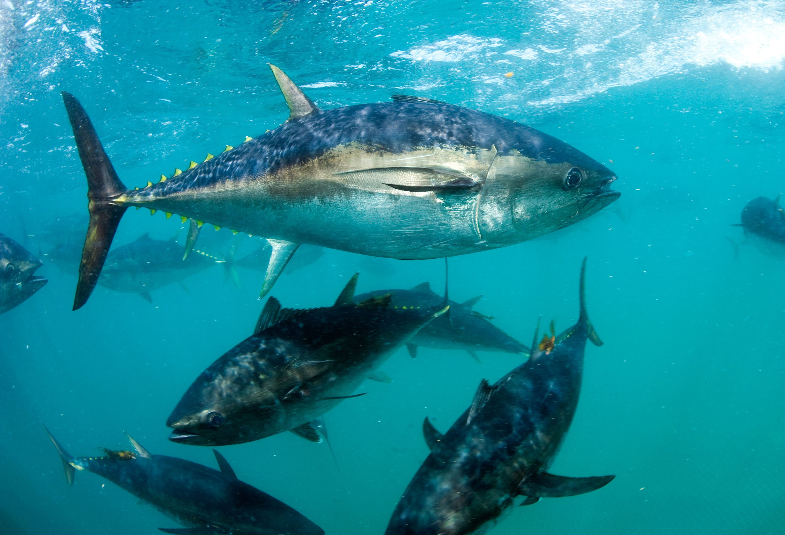
OTN IN YOUR REGION
Together, OTN and its collaborators are tracking oceans, connecting people and transforming knowledge
TRACK Using electronic tags to track more than 225 keystone, commercially important and endangered species.
CONNECT Connecting infrastructure, communities, resources, researchers, policy-makers, industry, and other stakeholders at local and global scales
TRANSFORM Transforming our understanding of the oceans by developing global data standards and a paradigm of collaborative research and management.
OCEAN TRACKING NETWORK
Notes:
TODO: add a Pacific region OTN splash page

Slide 4
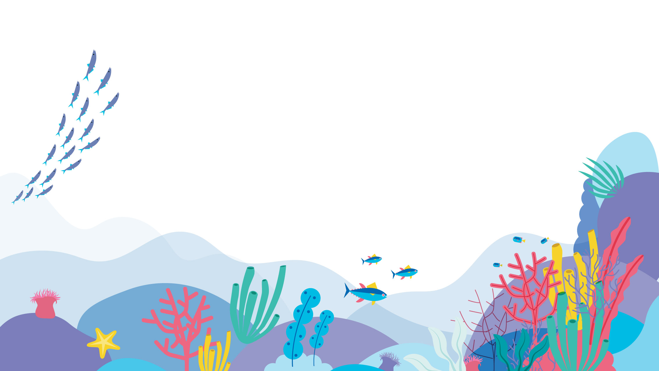
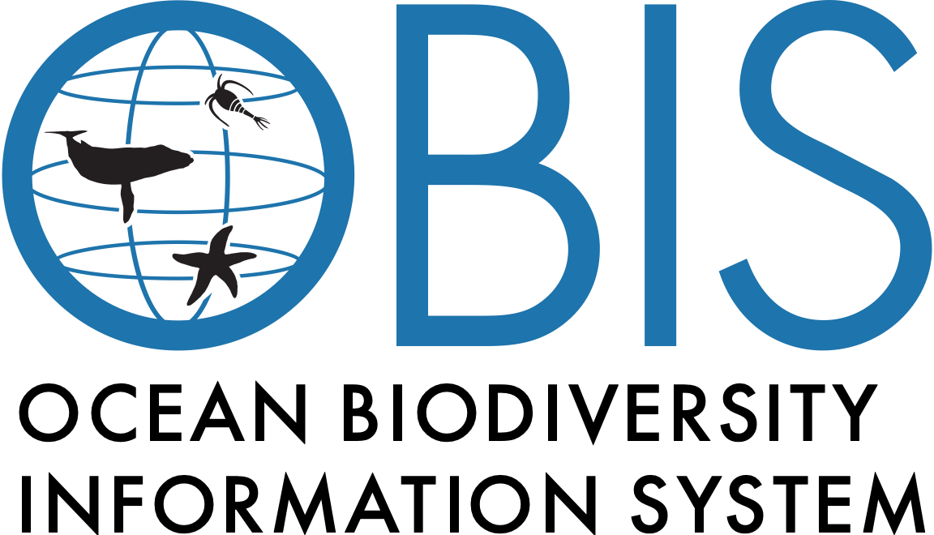
Notes:
To optimize the discoverability and re-use of the data we collect, OTN is a participating node of the Ocean Biogeographic Information System, which is a UNESCO-Intergovernmental Oceanographic Commission initiative to aggregate and make available the world’s understanding of marine animal presence and biodiversity. Our data, once released publicly, joins a huge and wide-ranging data system of all the ways in which humans (and our machines) have determined the presence of marine taxa in space and time.

Slide 5
A healthy ocean is a diverse ocean
Recreational space
Resources (e.g. medicine nutrition, transport)
Our ocean provides essential services to humankind
Bio-geo-chemical planetary processes
Ocean diversity
Notes:
Our ocean provides essential services to humankind, and we all know that a healthy ocean teeming with life performs these services much more effectively.

Slide 6
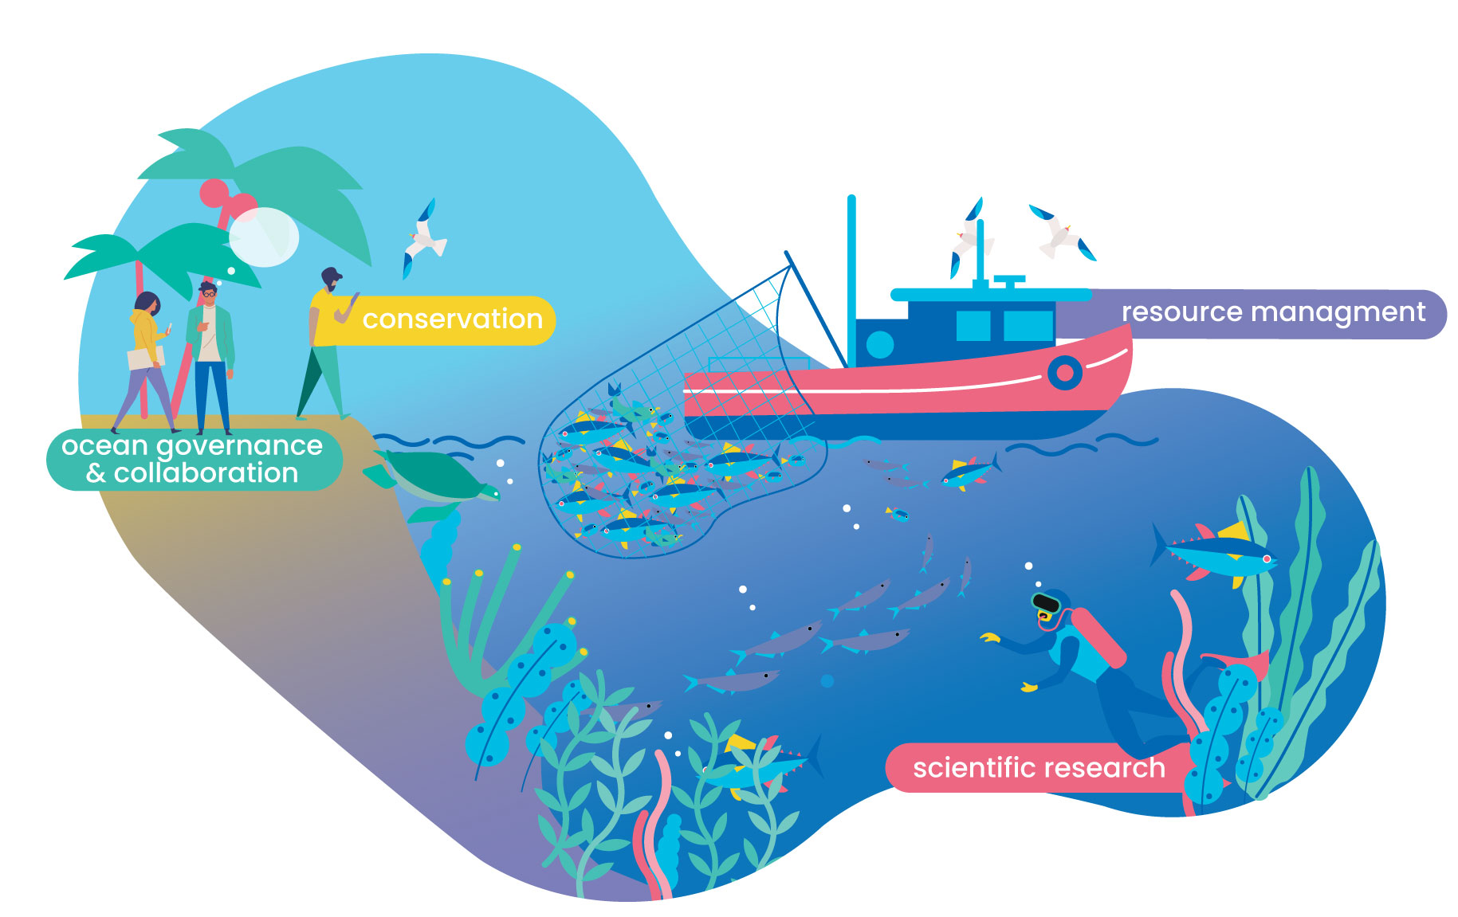
Sound scientific ocean management and conservation
starts with comprehensive biodiversity and biogeographic data
Notes:
However, our oceans’ biodiversity continues to be threatened and to counter global environmental issues and ensure the sustainable use of marine resources, we need data-driven research to inform conservation and ocean management.

Slide 7
Collect, analyse, archive, repeat
… but accessing such data requires extraordinary efforts from individual users to gather and assemble disjunct pieces of information.
A wealth of data about various marine species, habitats and whole ecosystems already exists,…
Notes:
A lot of data already exist, but the challenge lies in finding, accessing and making sense of the myriad of existing, but dispersed pieces of data.

Slide 8
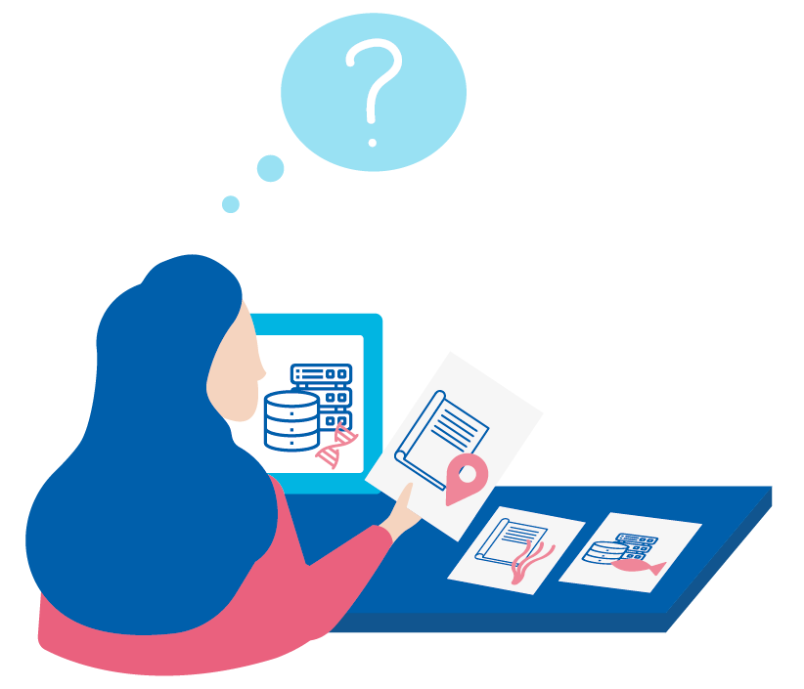
Collect, analyse, archive, repeat
Cohesion in information
Universal and comparable language use
Contextual information on how data was acquired
Modern databases often lack …
… causing confusion and making the assembly of complete information difficult.
Notes:
And what makes this endeavor even more challenging is that data are often not encoded following international data standards and best practices. Also, they often lack the necessary contextual metadata that is required to correctly re-use the data.

Slide 9
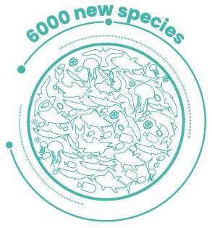
Census of marine Life
Between 2000 and 2010 the multimillion-dollar initiative saw collaborative and individual efforts from more than 2700 scientists and more than 80 nations, putting the discipline of marine science on the map, discovering more than 6000 new marine species and highlighting some of the most urgent threats to our oceans.
2000
2010
Notes:
The Census of Marine Life (2000-2010) – a multimillion-dollar initiative – represented the first collaborative efforts from more than 2700 scientists and 80 nations to strengthen our understanding of our ocean. And in fact, the initiative discovered more than 6000 new marine species, put the discipline of marine science on the map and highlighted the most urgent threats to our ocean.

Slide 10
OBIS:
Free, accessible and detailed marine data
Notes:
For 20 years now, OBIS has been building a central global platform that provides free access to the world’s ocean biodiversity and biogeographic data.

Slide 11
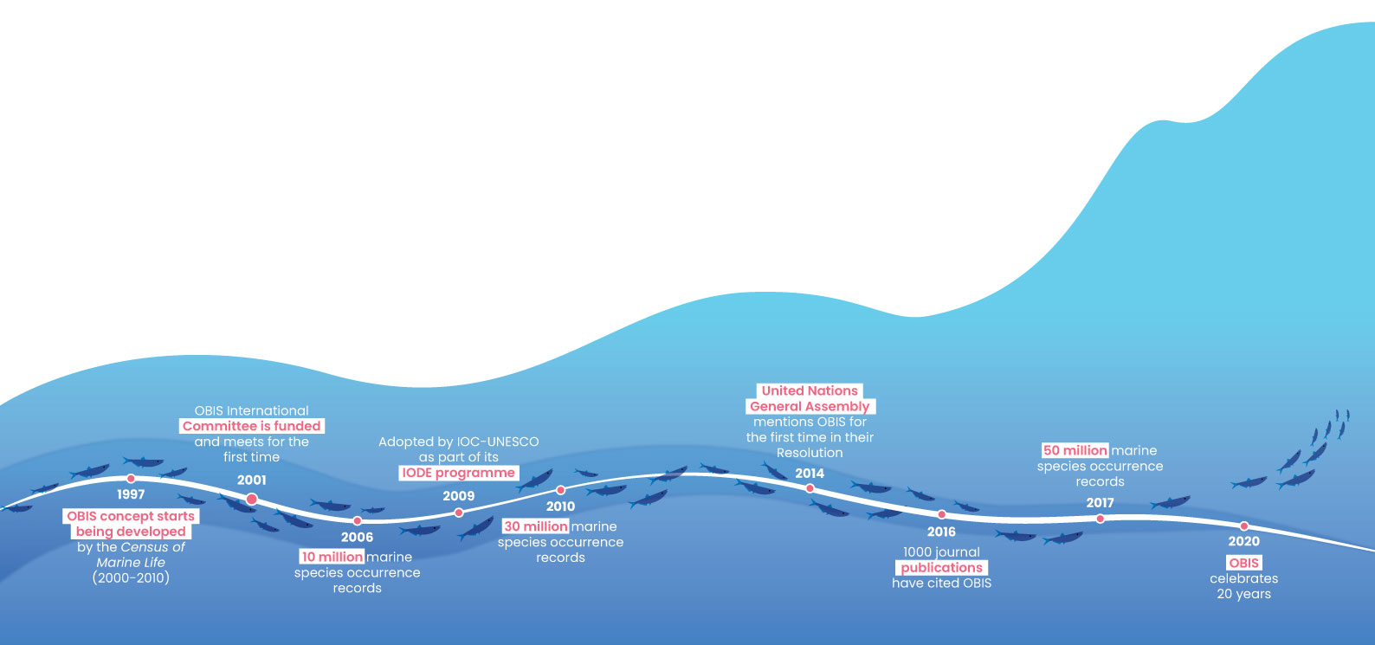
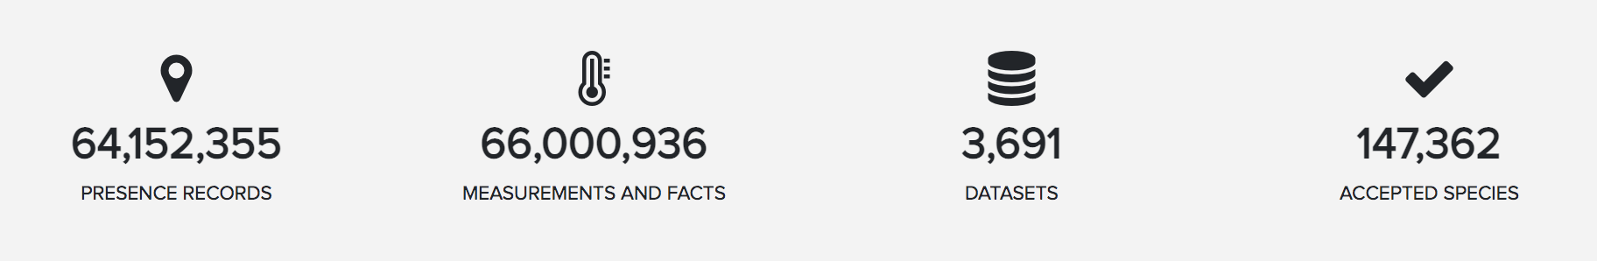
OBIS - Origins, history and achievements
Notes:
OBIS emanates from the Census of Marine Life. In 2000, when OBIS received its first funding the press release reported that “the ultimate vision of OBIS was that of an individual selecting any area or volume of water on a global map to bring up information on what has been reported to live there. OBIS would enable access by scientists and others to historical data on species distribution and abundance and provide a framework into which newly collected data can be placed”. [click] Today, OBIS integrates over 60 million presence records from 3691 datasets of nearly 150,000 marine species. And to give you an idea, this year we added 6 million records from 574 new datasets. That is more than 1 new dataset per day. Interestingly, the number of biotic and abiotic measurements and sampling facts now surpases the amount of occurrence records.

Slide 12
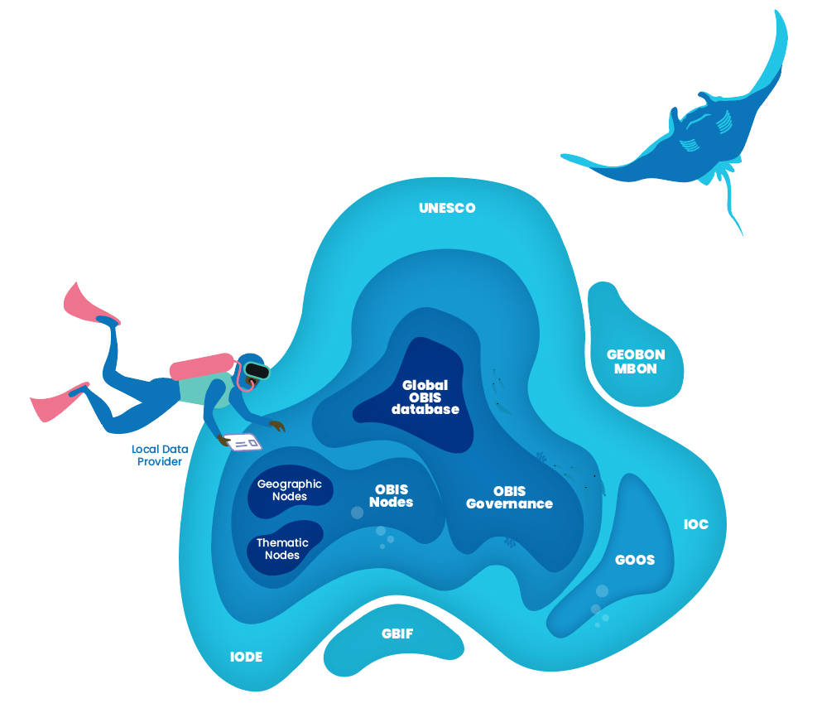
OBIS: Free, accessible and detailed marine data
But beyond this OBIS promotes a culture of cooperation by supporting training and capacity development.
At the core OBIS operates as a rich database on marine life, rooted in international collaboration. OBIS data is used to tackle common challenges that concern the marine environment.
Notes:
Realizing its importance, governments assumed the responsibility for OBIS, when the Member States of the Intergovernmental Oceanographic Commission (IOC) of UNESCO adopted OBIS in 2009, and OBIS became a project of the International Oceanographic Data and Information Exchange (IODE) program.
OBIS operates as a collaborative network of regional and thematic nodes and the global OBIS network promotes a culture of cooperation and supports training and capacity development, while also maintaining partnerships around the globe, with organisations such as the Marine Biodiversity Observation Network (MBON), the Global Ocean Observing System (GOOS) and the Global Biodiversity Information Facility (GBIF).

Slide 13
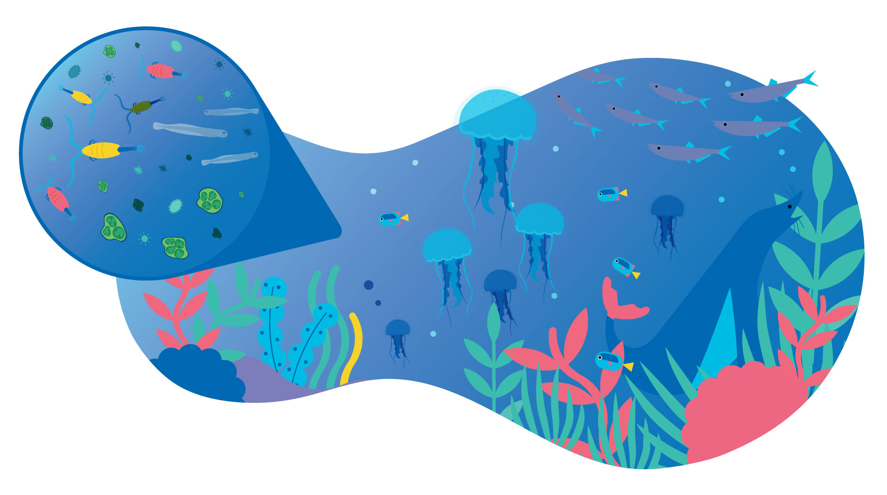
OBIS
Data life cycle
Notes:
A lot of human and financial resources have been and are being invested into the collection of a vast amount of biodiversity data ranging from records of small microorganisms to megafauna, from the tropics to the poles and from the surface to the deepest trenches. The more than 60 million records in OBIS is a compilation of this diversity.

Slide 14
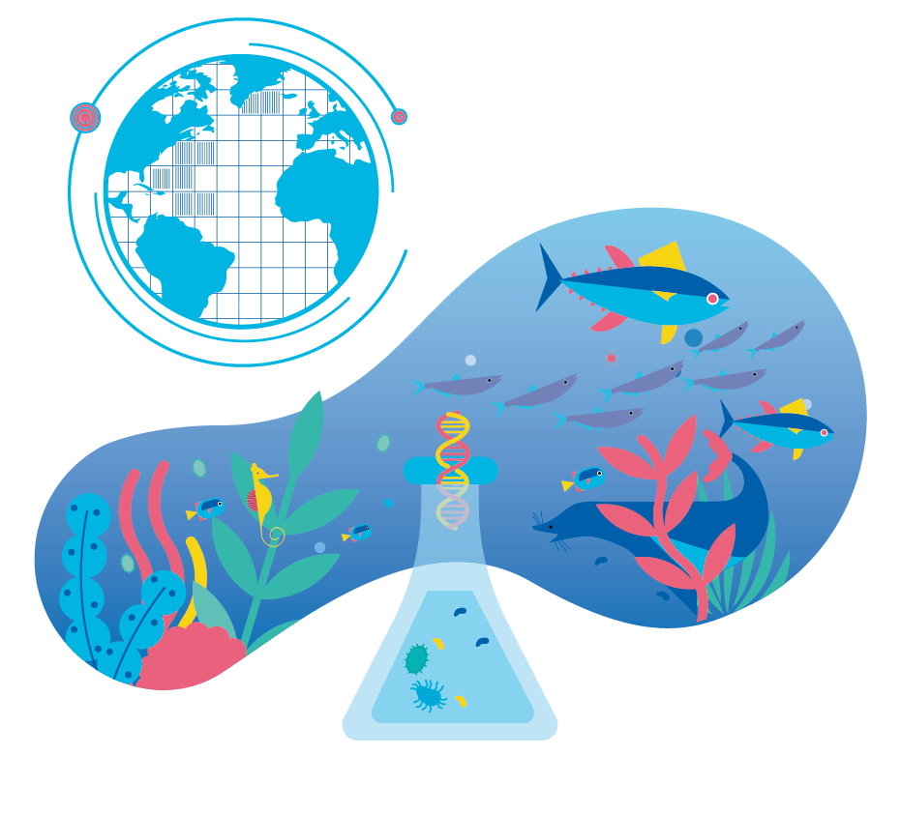
From Nature to Numbers
Presence/Absence data
can originate from sporadic sightings or novel detection methods such as environmental DNA. This quantitative data allows the establishment of species ranges.
Notes:
The core of OBIS are the PRESENCE and ABSENCE DATA. These records can represent point locations, but can also be part of line transects from trawling, or polygons, or even a point in a grid for cases where the exact location cannot be disclosed.

Slide 15
From Nature to Numbers
Abundance data
represents the number of individuals of a species in a given area or volume of seawater or sediment. This is a key metric for the conservation of vulnerable organisms and the management of species populations like fish stocks.
Notes:
From its inception, OBIS was also capturing ABUNDANCE DATA, which represents the number of individuals of a species in a given area or volume of sea water or sediment. This is a key metric for the conservation of species and the management of species populations like fish stocks. Because the Impact of environmental change will happen first at the abundance level, and may not be detected immediately in species presence/absence data.

Slide 16
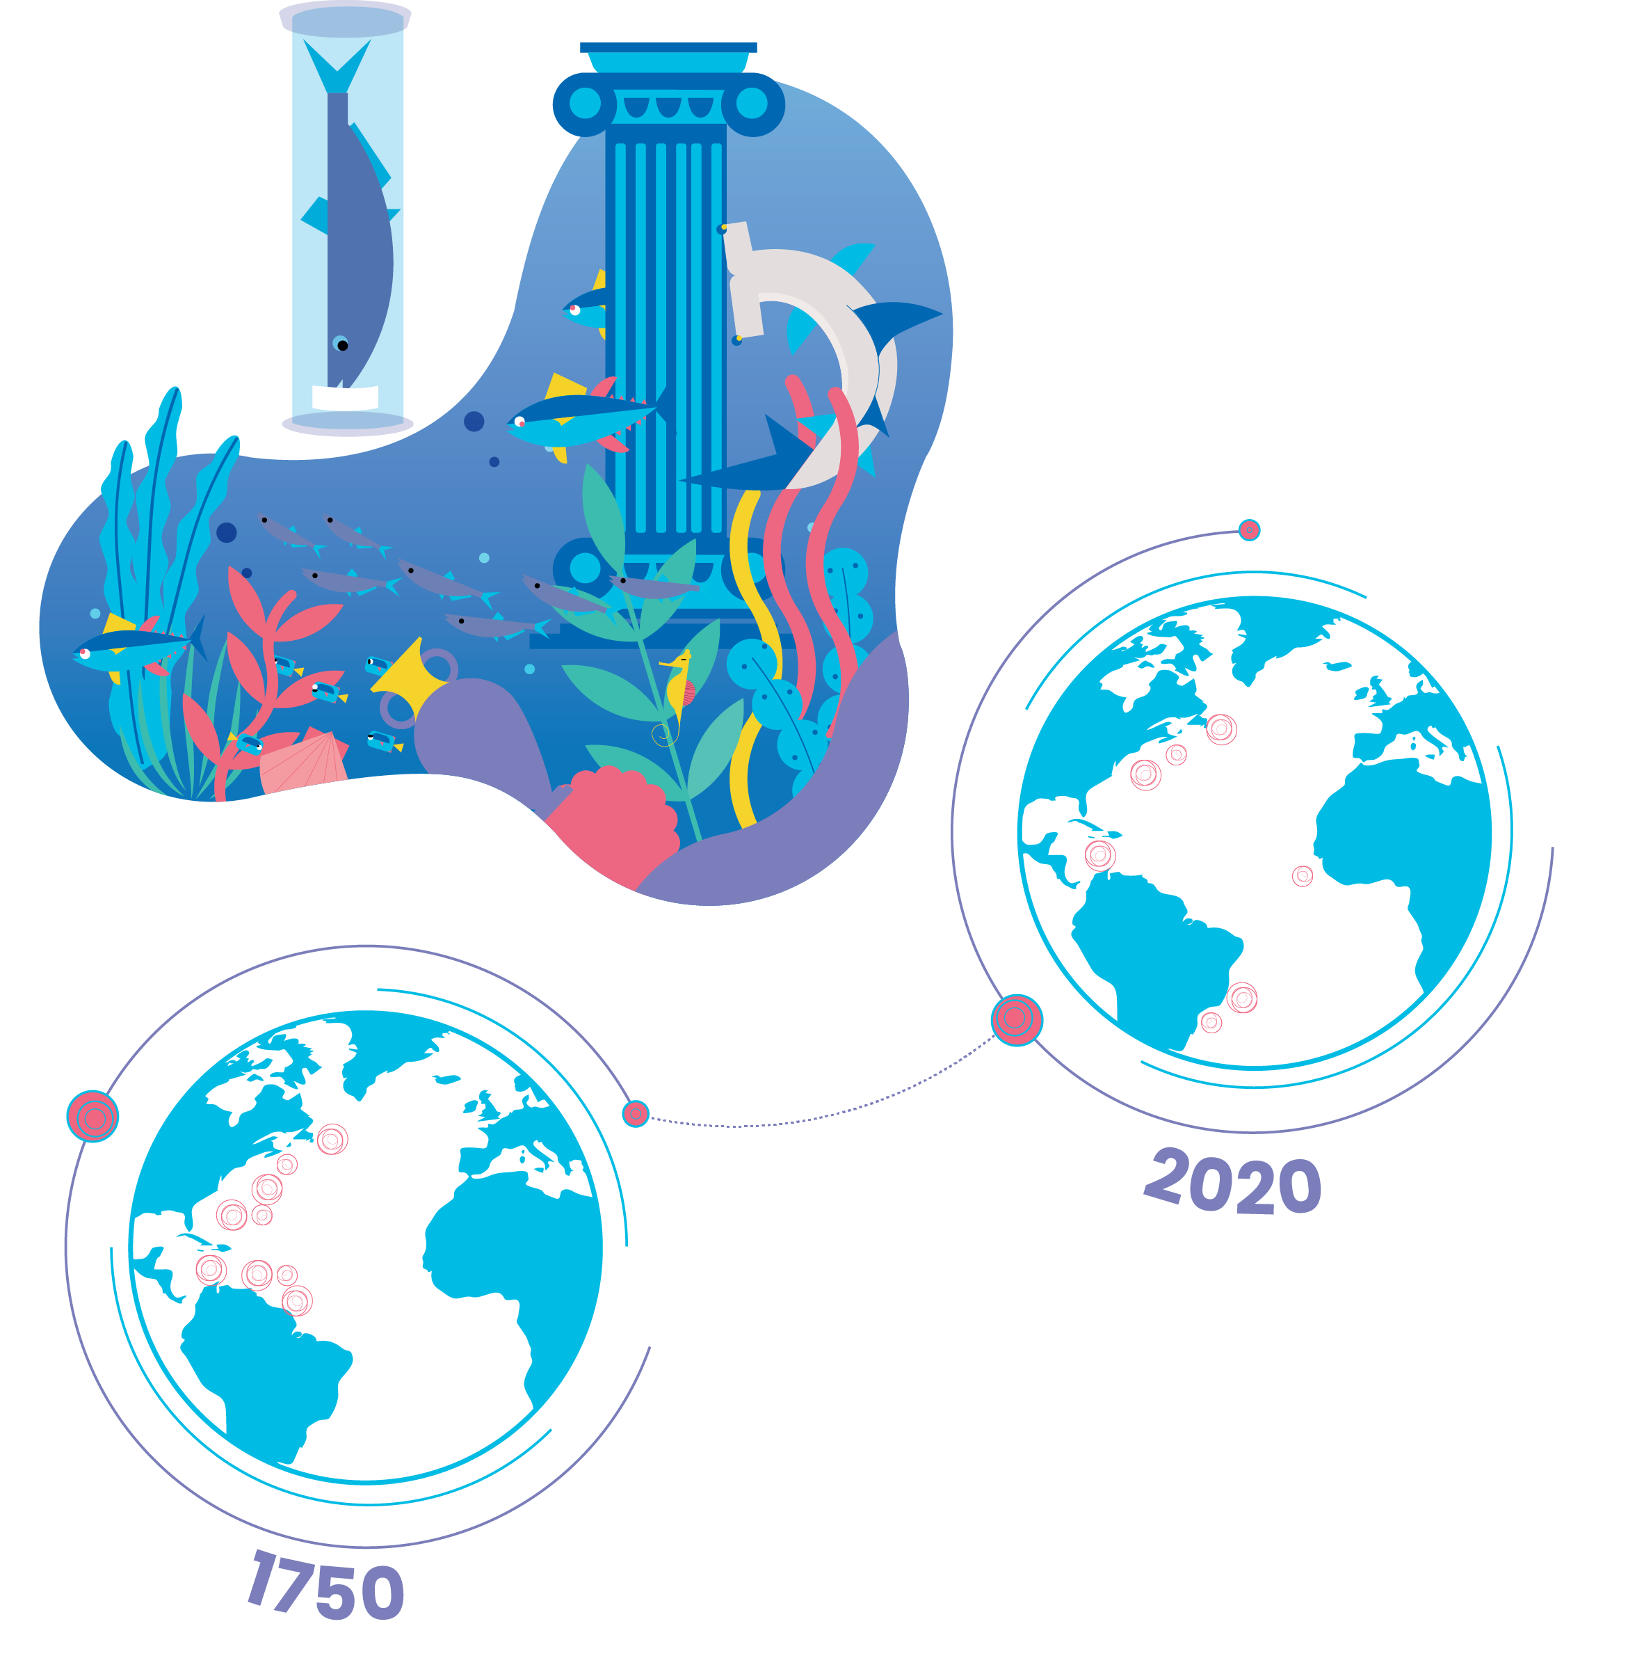
From Nature to Numbers
Historical data
characterises historic records and findings preserved in archives, libraries and older data series which enable comparative analysis over time.
Notes:
Half of the data in OBIS (about 30 million records) are from sampling events before 2000 (when OBIS started) and we have 4 million records from before 1970. So a lot of our efforts have focused on digitizing historic records preserved in archives, libraries, museum collections. These older data provide us an important baseline that enables comparative analysis over time.

Slide 17
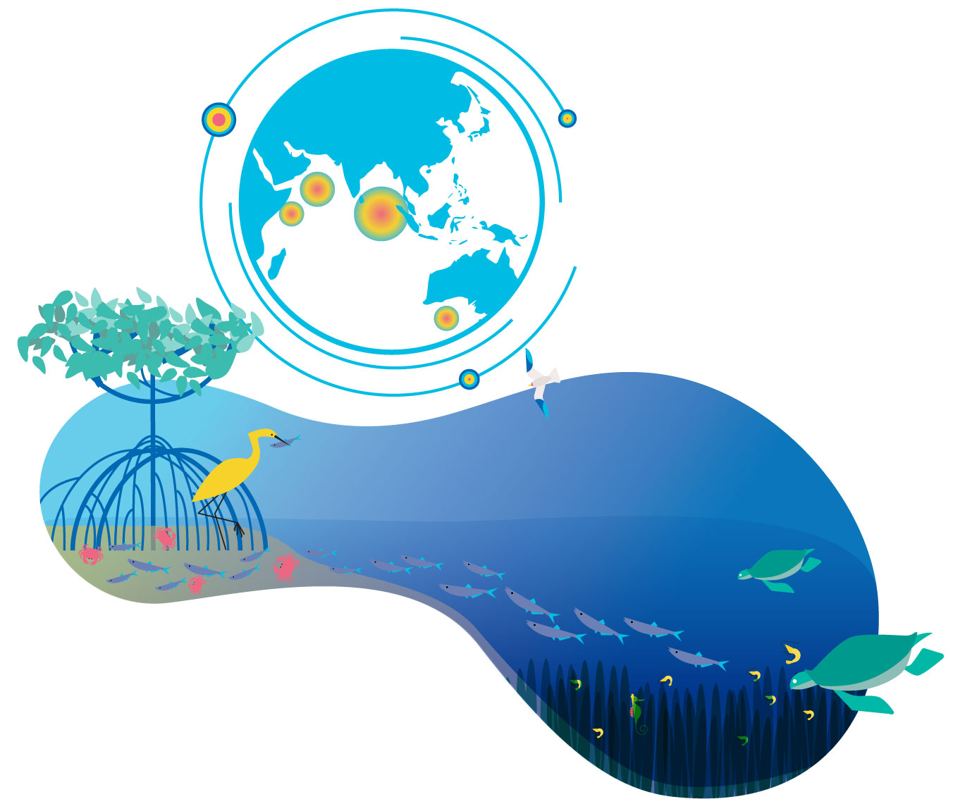
From Nature to Numbers
Habitat data
represents data about biological as well as habitat and geographic diversity.
Notes:
Recently OBIS holds data on HABITATS, such as live coral cover, and seagrass meadows. These habitat ecosystems are often near the coast, providing and supporting key ecological services but are under increased stress from human activities. Monitoring the status and change of key habitats is one of the priorities of the Global Ocean Observing System.

Slide 18
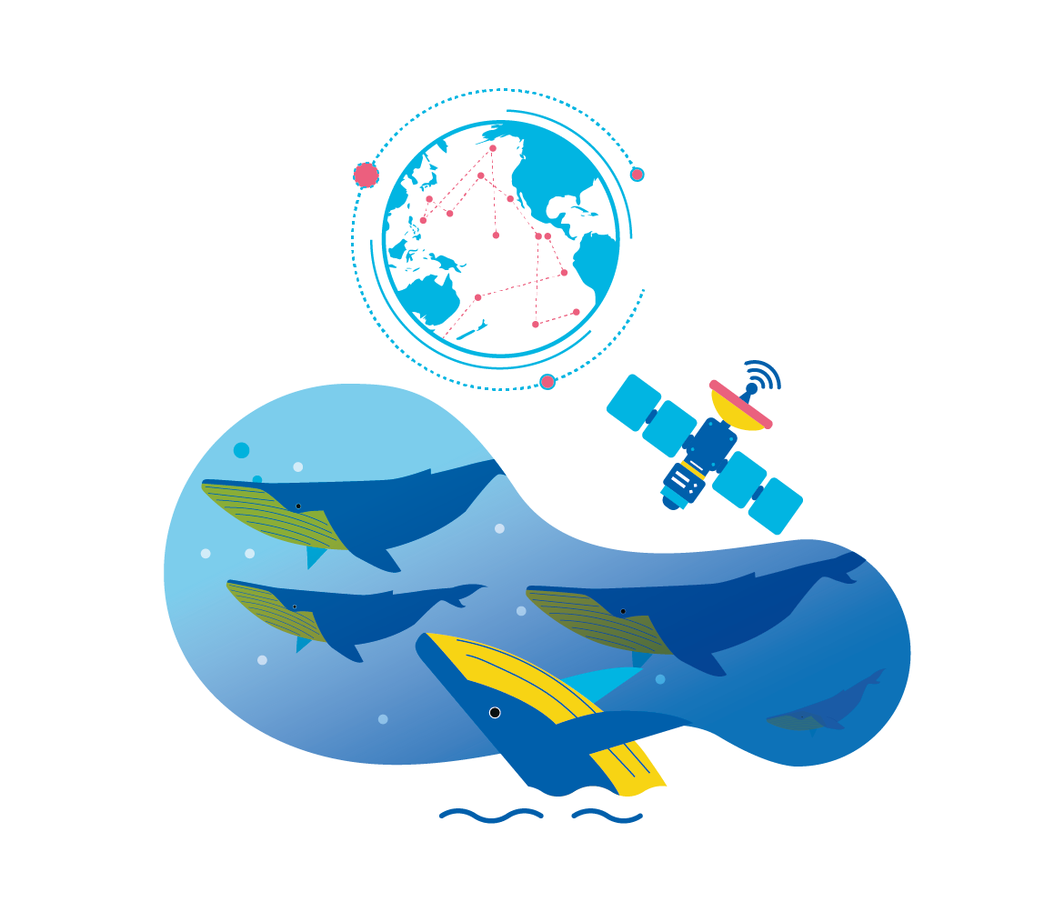
From Nature to Numbers
Tracking data
represents movement data that follows animals via satellites or bioacoustics.
Notes:
Also recent additions to OBIS are TRACKING DATA from tagged animals that are tracked via satelites or acoustic receivers. Animal tracking helps us understand the dynamics of animal movements, discover migration pathways and connectivity between areas, which is important information for more effective conservation and management.

Slide 19
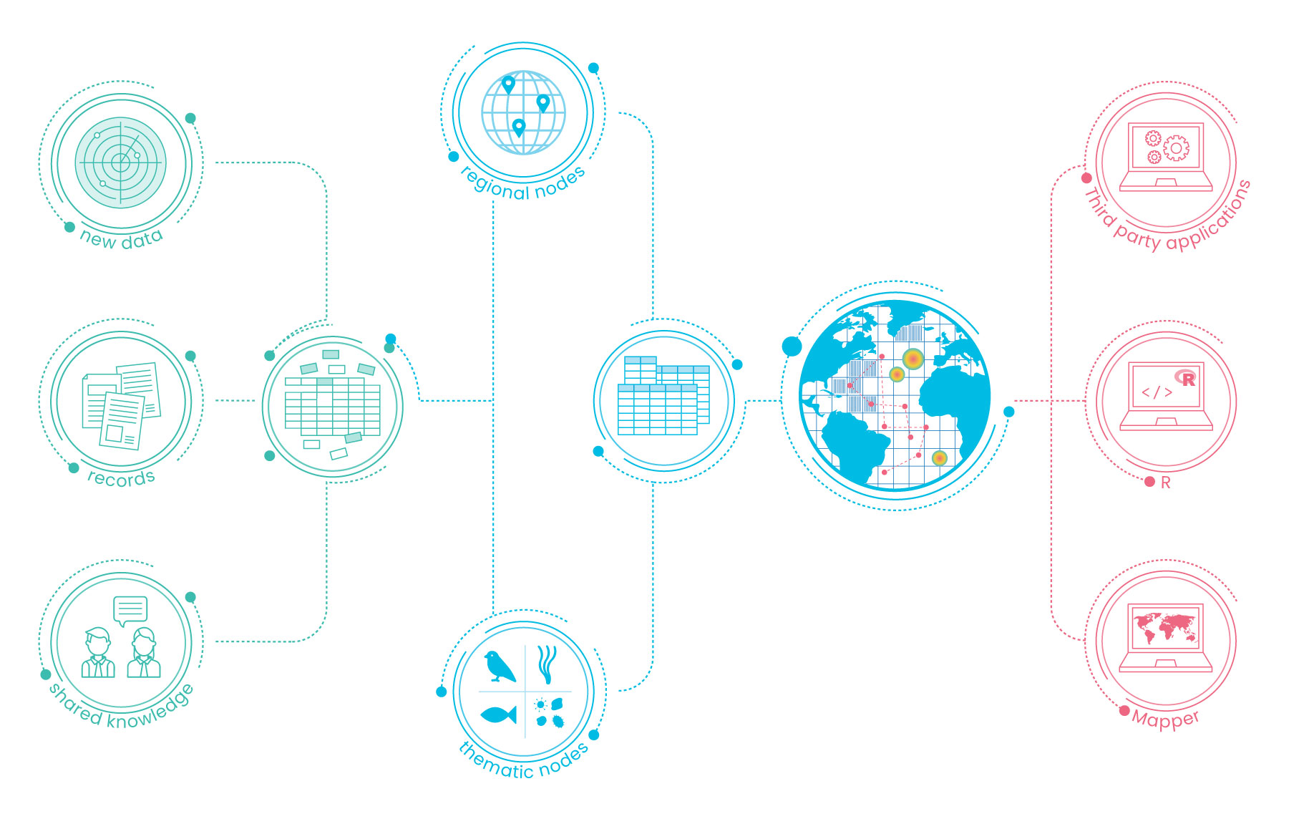
OBIS Data life cycle
Collection:
Integration:
Publication:
Notes:
It all starts with the over 1,000 data providers or data stewards who are willing to publish the data in the public domain. The data is standardized and quality controlled at the 31 regional or thematic OBIS nodes from where the central system harvests it, performs an extra QC step and publishes the integrated set. The API webservice powers the OBIS mapper, R package and third party applications, where data can be discovered and downloaded free of charge.

Slide 20
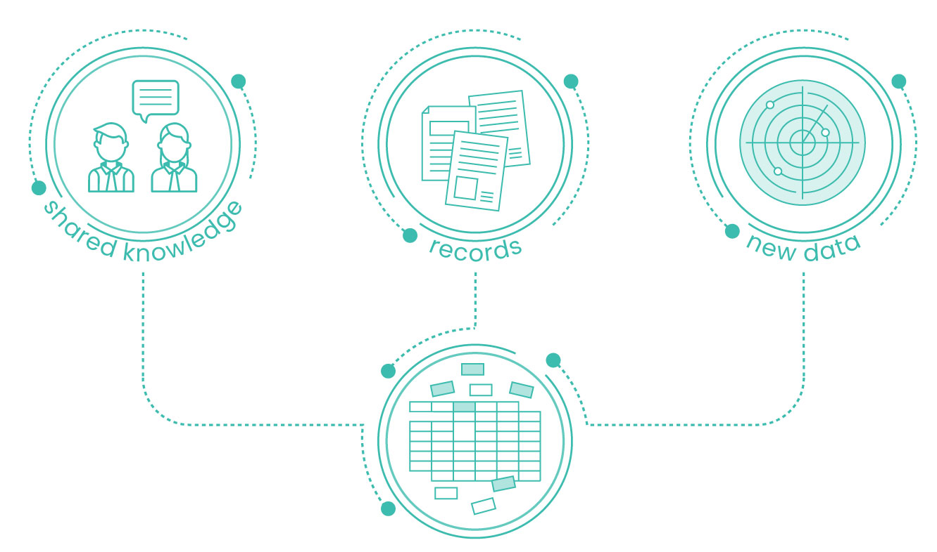
OBIS
Data life cycle
Collection:
Data is compiled from multiple observations
Notes:
Much of the future of scientific discovery, conservation management and policy will therefore rely on making sense of existent data in connection with novel findings. With this in mind OBIS was founded as an holistic reservoir of ocean biodiversity and biogeographic data.

Slide 21
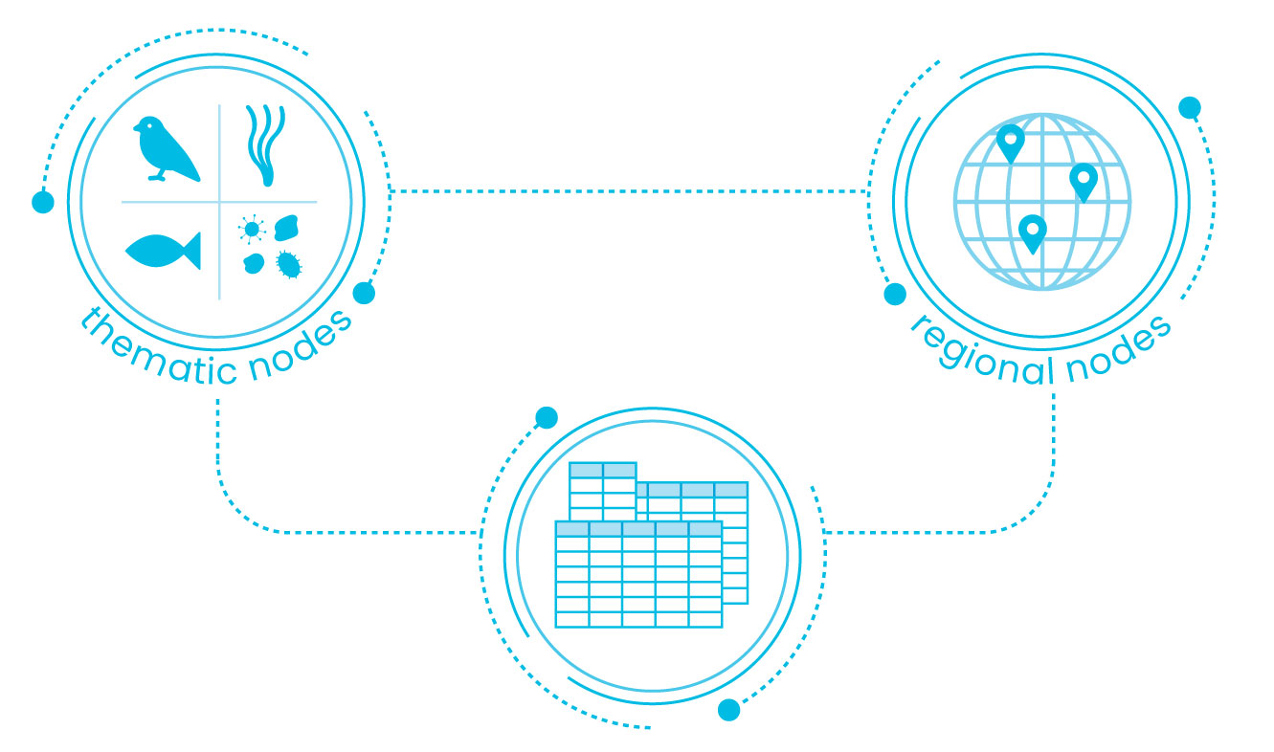
OBIS
Data life cycle
Contribution:
During the standardisation process the OBIS thematic and regional nodes check data quality and apply Darwin Core Standards
Notes:
Before contributing data to the OBIS archive, the network of regional and thematic OBIS nodes execute stringent quality checks, such as validating accurate scientific nomenclature, and transform the data to meet Darwin Core standards and, ultimately, magnify the available data.

Slide 22
OBIS
Data life cycle
Contribution:
The data is then deposited in the OBIS database and made accessible to everyone
The OBIS database follows FAIR guiding principles of scientific data management and stewardship
Notes:
Open-access to standardized and enriched data follows the FAIR principle of scientific data: findable, accessible, interoperable and reusable. Moreover, the inclusion of event-based data, such as details about sampling method, adds contextual depth to OBIS data sets.

Slide 23
OBIS
Data life cycle
Access:
Mapper on OBIS server
R (analytical platform) & robis package
Third party application
Notes:
Data stored on the OBIS database can be accessed via the online Mapper, the R package robis or third party applications powered by the OBIS API webservice.

Slide 24


Capacity Development
OBIS
Data life cycle
Build, improve and retain skills
Notes:
Capacity development is an essential activity in OBIS. So far we have trained more than 300 people from 71 countries in 23 training courses. These training courses are organized in partnership with networks such as EMODNet in Europe and MBON in the US, and with this very course. Our training courses are hosted and available via the e-learning platform of the OceanTeacher Global Academy. Trainees are trained in applying the Darwin Core standards, using our QC tools, publishing the data and doing analysis on the data.

Slide 25
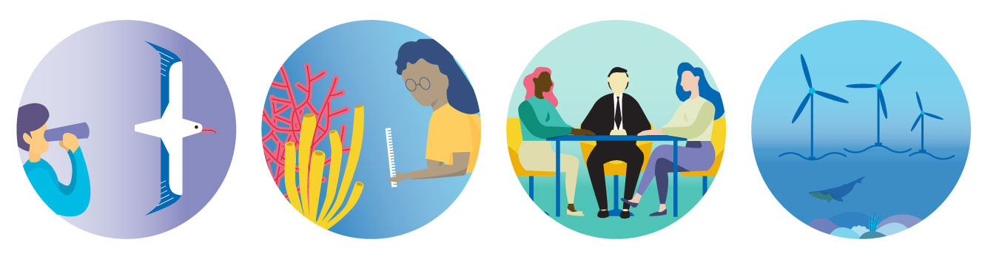
OBIS CASE STUDIES:
Notes:
The application of OBIS data ranges from scientific research and conservation management to impact assessments and ocean governance.
More than 1,500 publications have cited OBIS so far, of which several are high impact papers and more and more of them are reporting on important global-scale environmental policy concerns such as the impact of climate change.

Slide 26
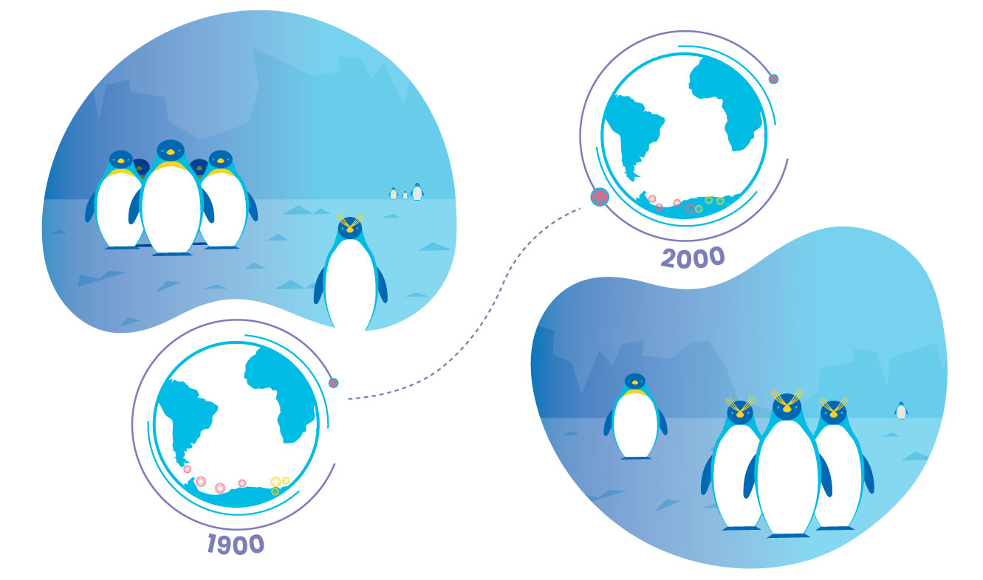

Use cases: Climate Change and Biodiversity research
“OBIS is really good at establishing trust with who collects the data and giving credit to scientists generating data. They magnify the effect of each contributor so that each scientist is properly acknowledged.”
Maria Dornelas
University of St. Andrews, UK
Climate change has altered the distribution ranges of marine species
Notes:
Such as this Science paper from Maria Dornelas. The analysis showed that climate change shrank, widened and overall altered species ranges, permanently transforming communities.

Slide 27
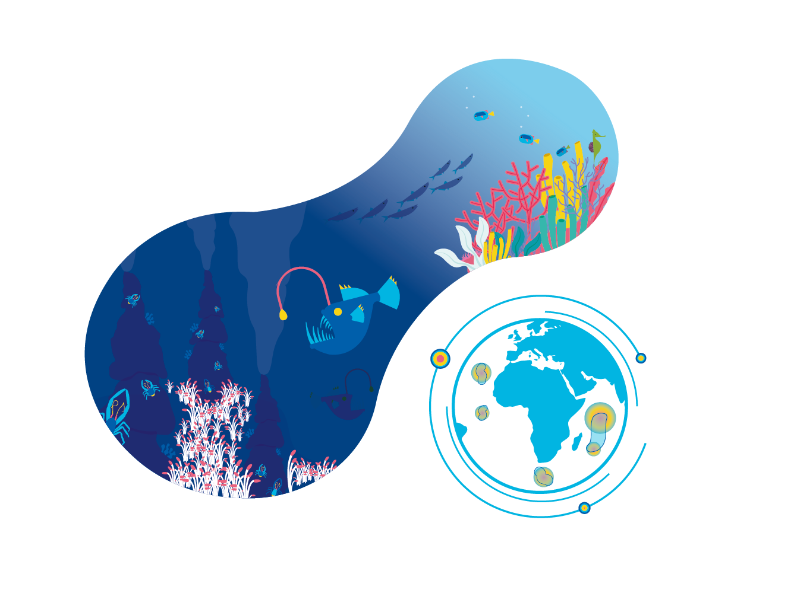

Use cases: Conservation of Ecologically Significant Areas
“I have used OBIS data multiple times.
It is marvelous.
The standardisation by OBIS nodes makes data comparable and adds real value and depth to our research.”
Mark Costello
University of Auckland, New Zealand
Combining OBIS data on species diversity, richness and endemicity, with environmental data, researchers identified 30% of the ocean area as having immediate concern for conservation.
Notes:
Or this work led by Mark Costello which identified 30% of the ocean that is of immediate conservation concern responding to a call from the International Union for Conservation of Nature (IUCN) to protect 30% of the ocean.

Slide 28
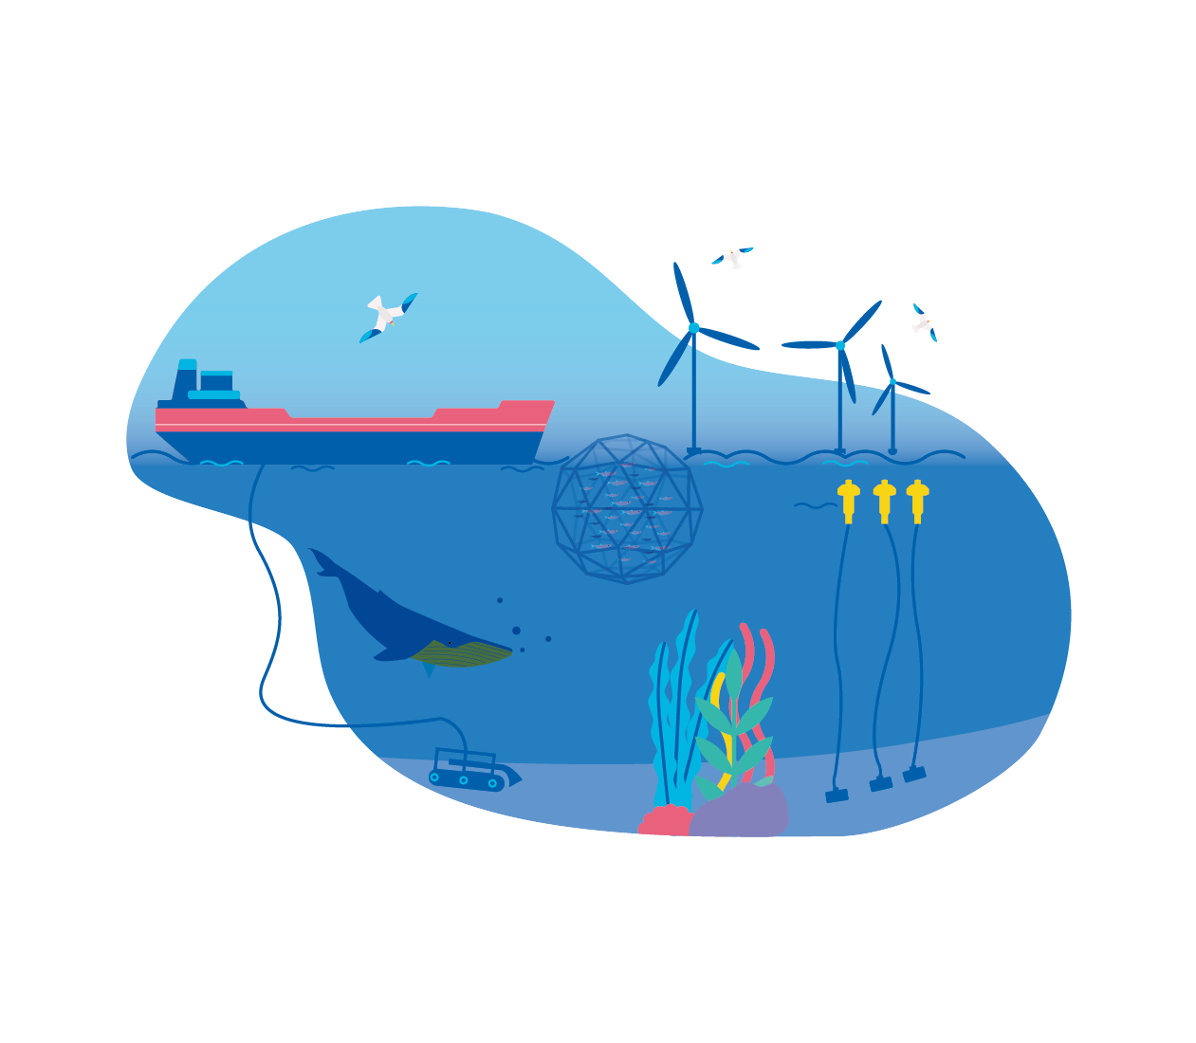
Use cases: Private Sector Usage
Ecological impact assessments are now essential to unite economic considerations with ecological concerns
Notes:
OBIS data is regularly recommended as a trusted source and is used for environmental impact assessments, such as for the extraction of valuable resources via mining or the exploitation of wave and wind energy.

Slide 29

Use cases: Regional
and Global Ocean Governance
“Sharing of knowledge
(e.g., OBIS) and open access to information and data streams, particularly across sectors, should be encouraged in order to ensure that the data collected are made available to all.”
2nd UN World Ocean Assessment
Regional and global policies base their decisions either directly on OBIS data or on research, which employs OBIS data.
Notes:
The future of data-driven policy making will rely on good data and sharing of information (“collect once, use many times” principle). The standardised and historic data compiled in OBIS for instance allows to improve country statistics for reporting on the state of the environment. The UN World Ocean Assessment and global and regional assessments under the Intergovernmental Platform on Biodiversity and Ecosystem Services use and recommed OBIS as a trusted source.
Ultimately, free access to data removes historic barriers of inequality and allows everyone to tackle marine concerns based on the best information available.

Slide 30
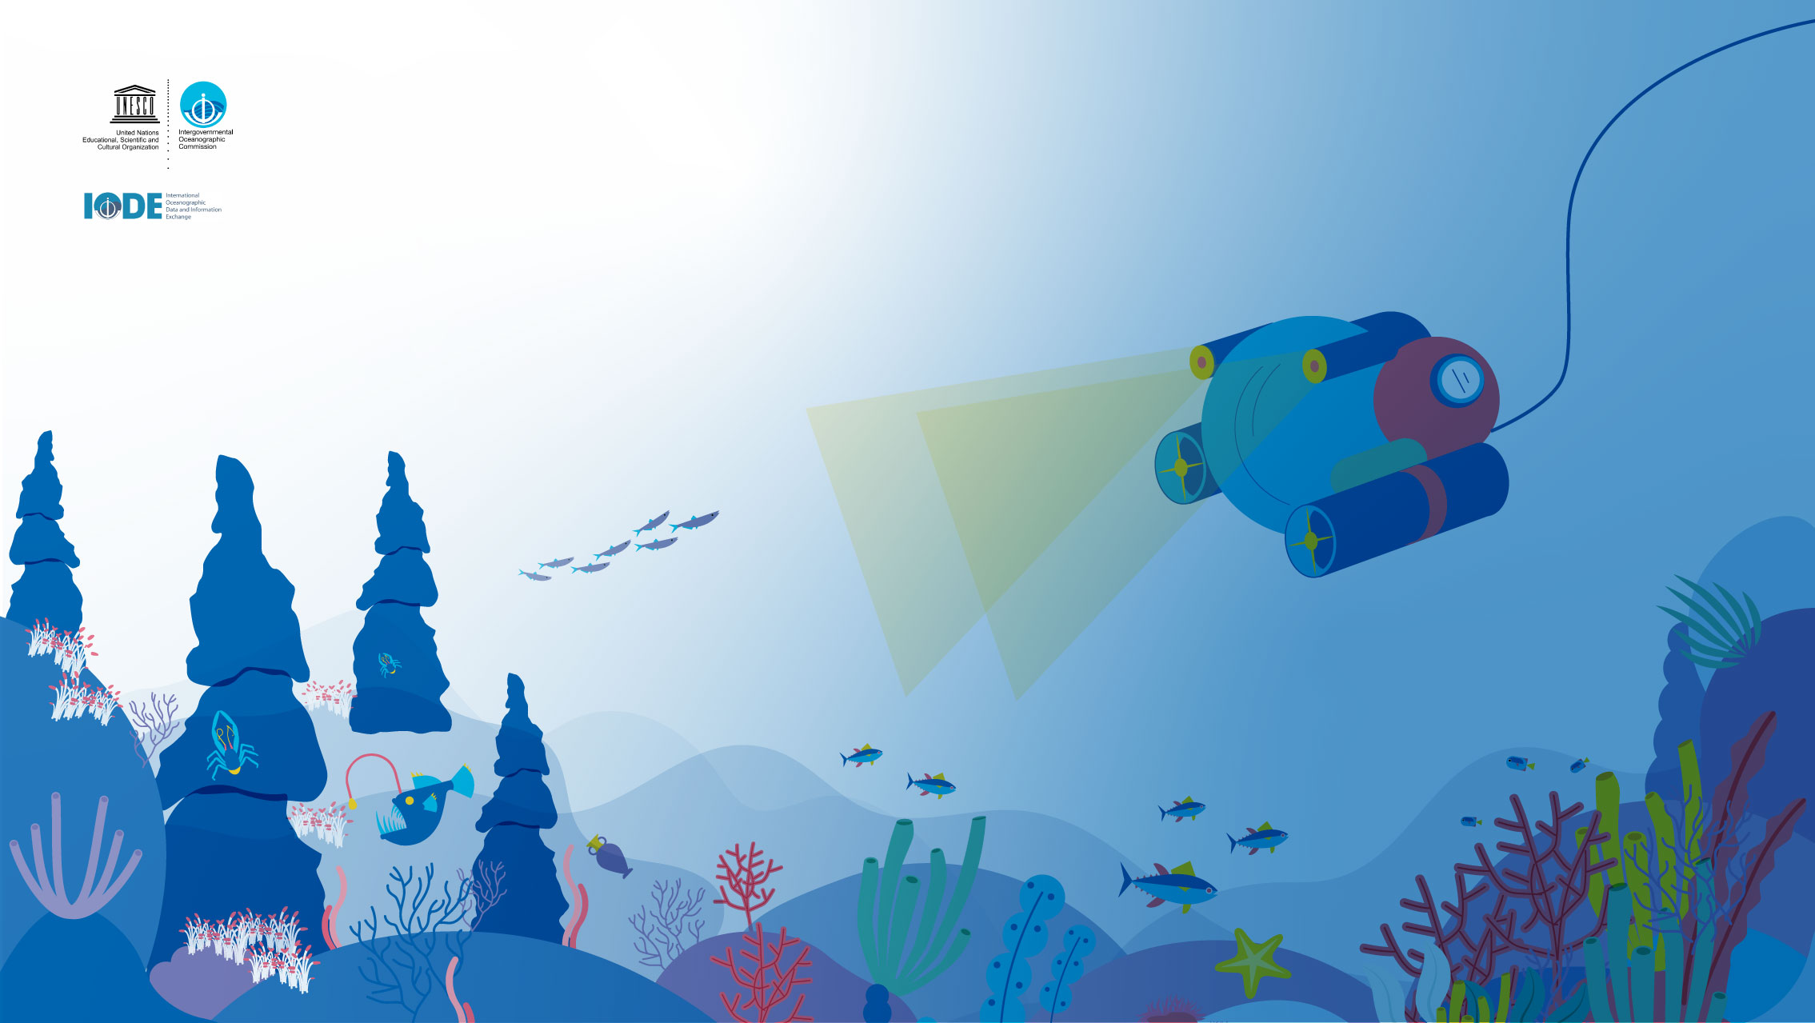
Thanks
Notes:
I wish to thank to all the supporters, donors and the thousands of scientists and the hundreds data managers who have been involved and contributed to OBIS. Without their efforts we would not have this fantastic resource to use today and in the future by our children.

Slide 31
OBIS Training – Winter 2021
Jon Pye, Brian Jones, Naomi Tress
Ocean Tracking Network Data Centre

Slide 32

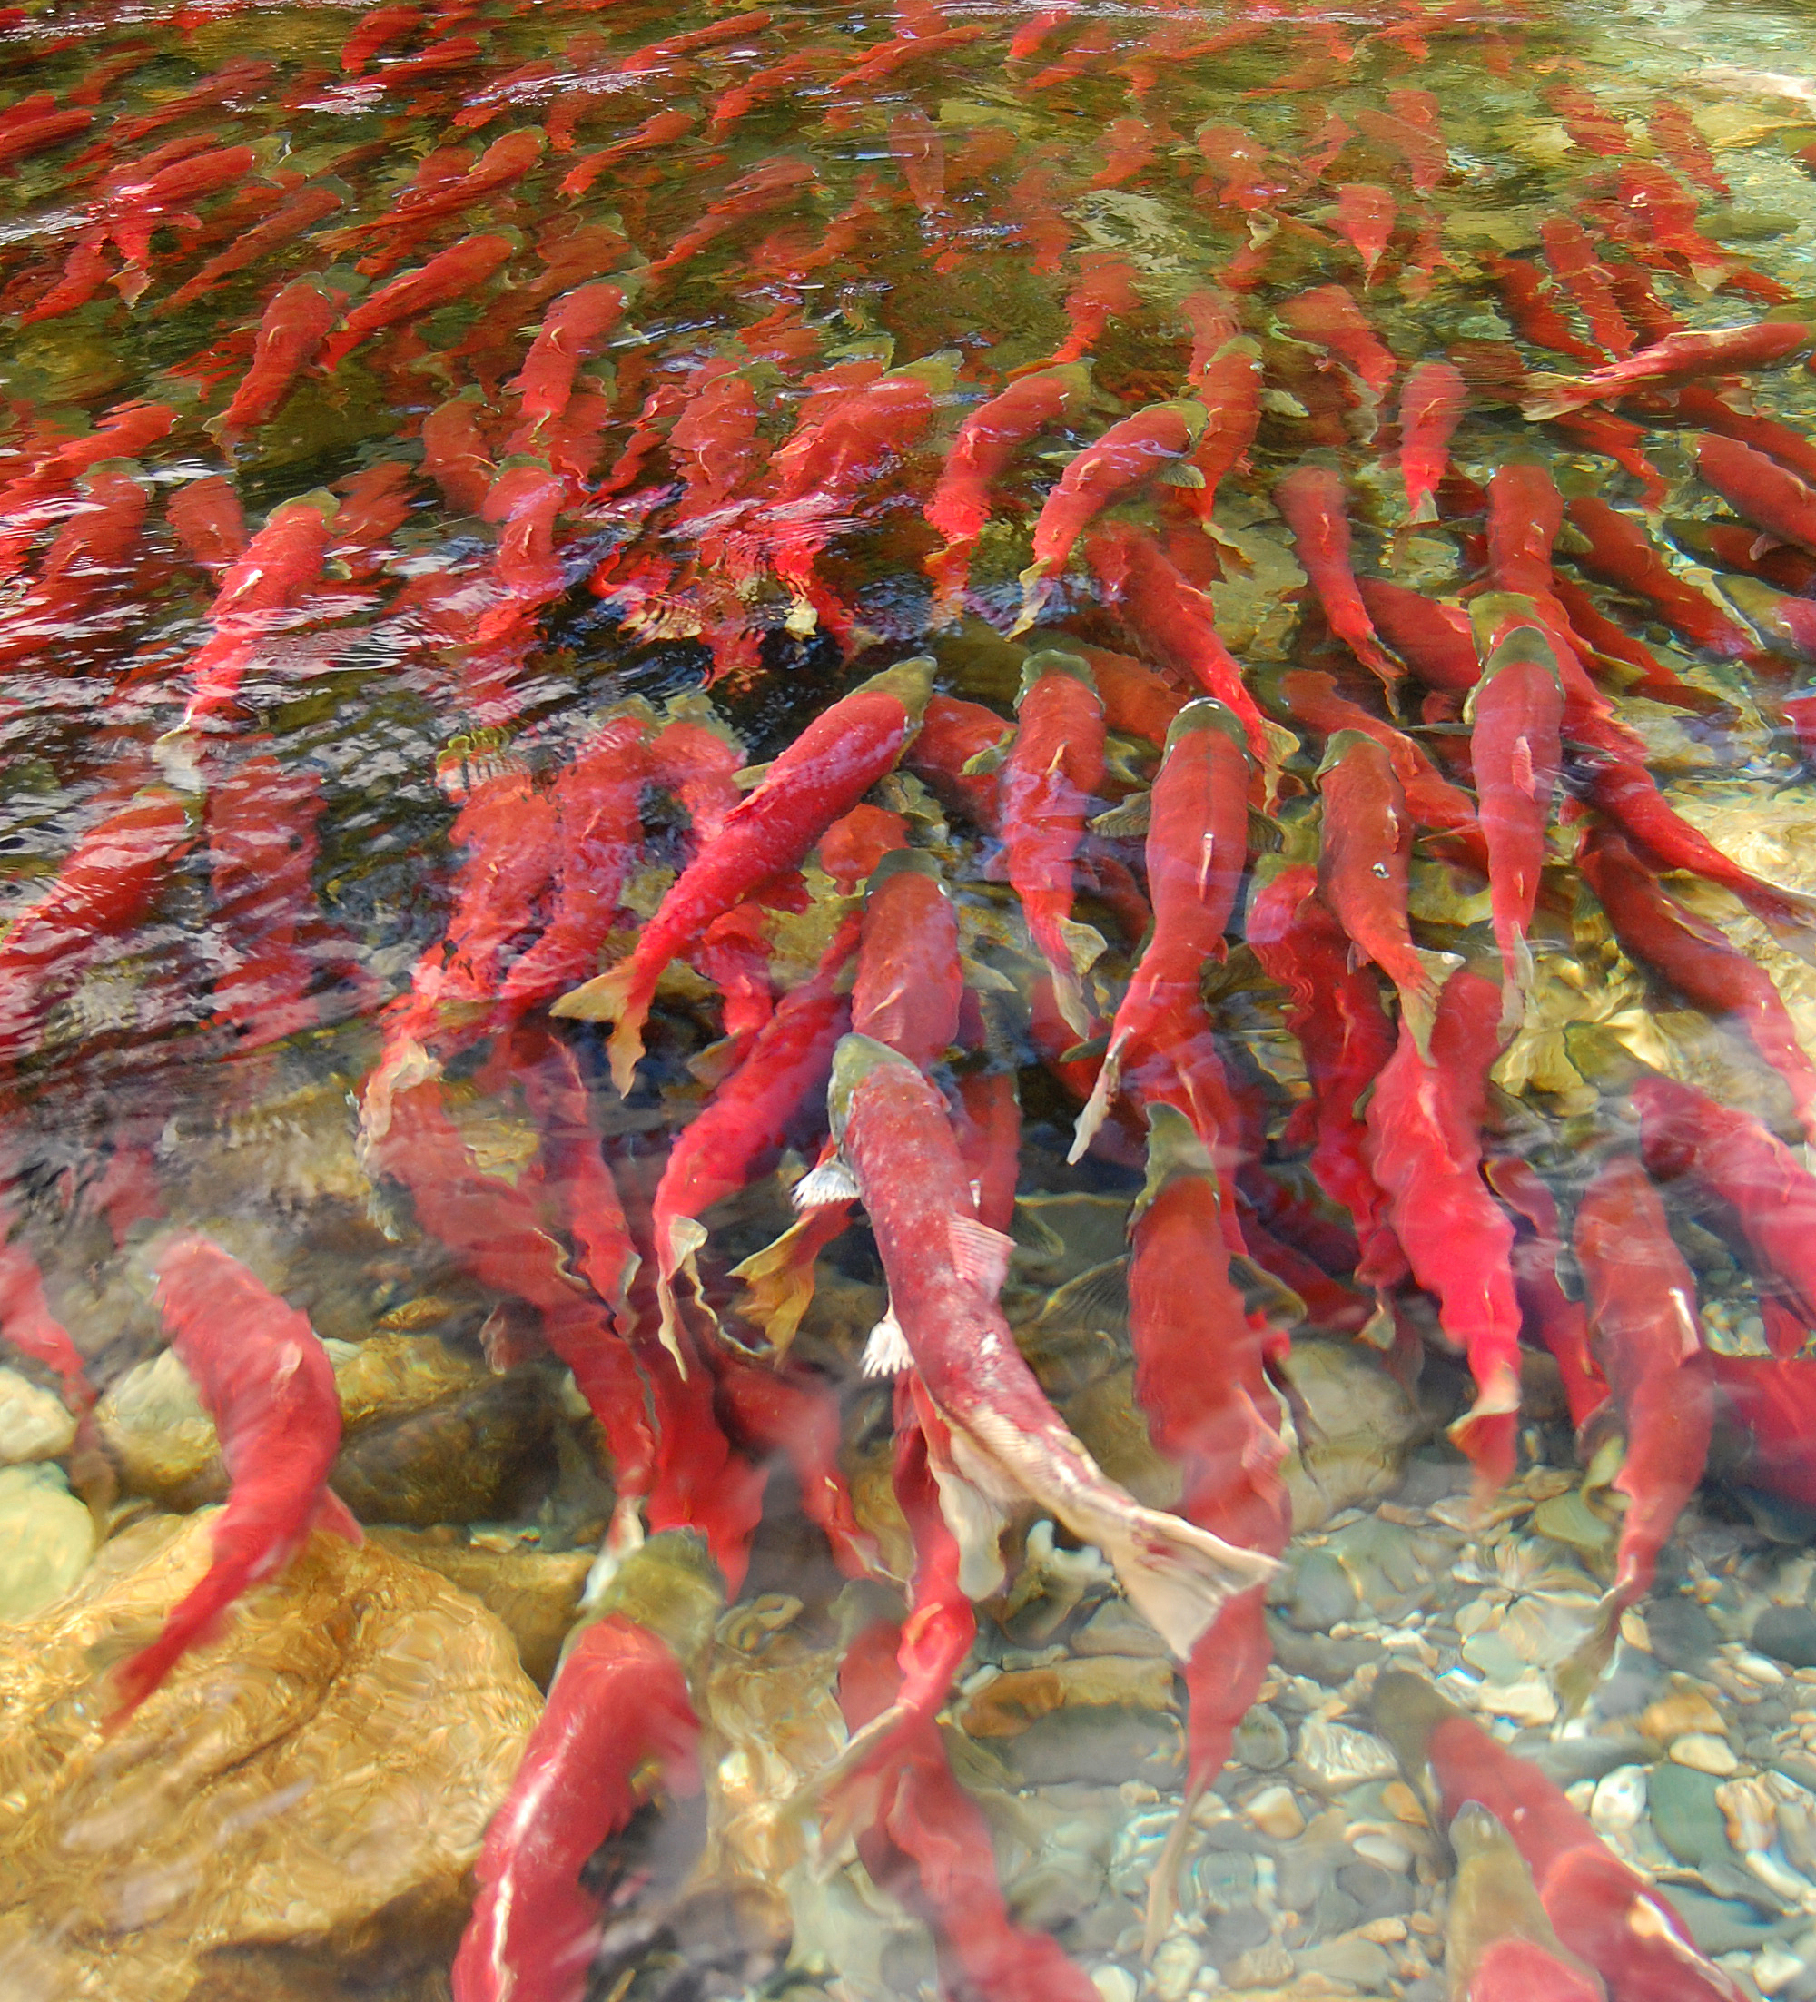
Workshop Schedule
Day 1
Intro to OBIS , [you are here!], WoRMS
Darwin Core terms and record types
OBIS Data Formats I (Darwin Core)
OBIS Metadata Formats (EML)
Hands-on session 1 – Data formatting / processing in R, taxon matching, QC using R , and the robis and obistools packages
Discovering OBIS-held datasets
Via the web mapper
Via the API
Via the robis/obistools packages
Day 2
OCEAN TRACKING NETWORK
Notes:
So here’s the workshop schedule for the next few days. We’re giving you the run of what OBIS is and why it’s great, next I’ll talk to you about the first of the quality control resources that OBIS helps make available to you, then we’ll go over how Darwin Core terminology works, where to find help with it, and the different ways you can assemble a Darwin Core archive. Hopefully by then it’s lunchtime, and we can talk about how those Darwin Core archives become OBIS datasets and what the format for OBIS dataset metadata is. We’ll then work together to sketch out how you might do some data processing and taxon matching and quality control using all the tools above in your existing data ingestion workflow.
Tomorrow, we’ll talk about how OBIS aggregates data from its member nodes into the international data system, what IOC’s data policy means, and more about the EML format for the project level metadata and how that’s accepted by the OBIS IPT. We can go over how to register datasets with an OBIS IPT both by hand and using some of the API-backed tools that Brian has written some demos for. That’s all the instruction that I think you’ll find relevant to your situation, so from there on we’re going to do some hands-on sessions. We’ll look at an example of an OGSL biodiversite dataset and how it maps to Darwin core terms, map the metadata and data to Occurrence core, which is pretty easy, and then we’ll take on Event Core together, which is harder and more subjective.

Slide 33
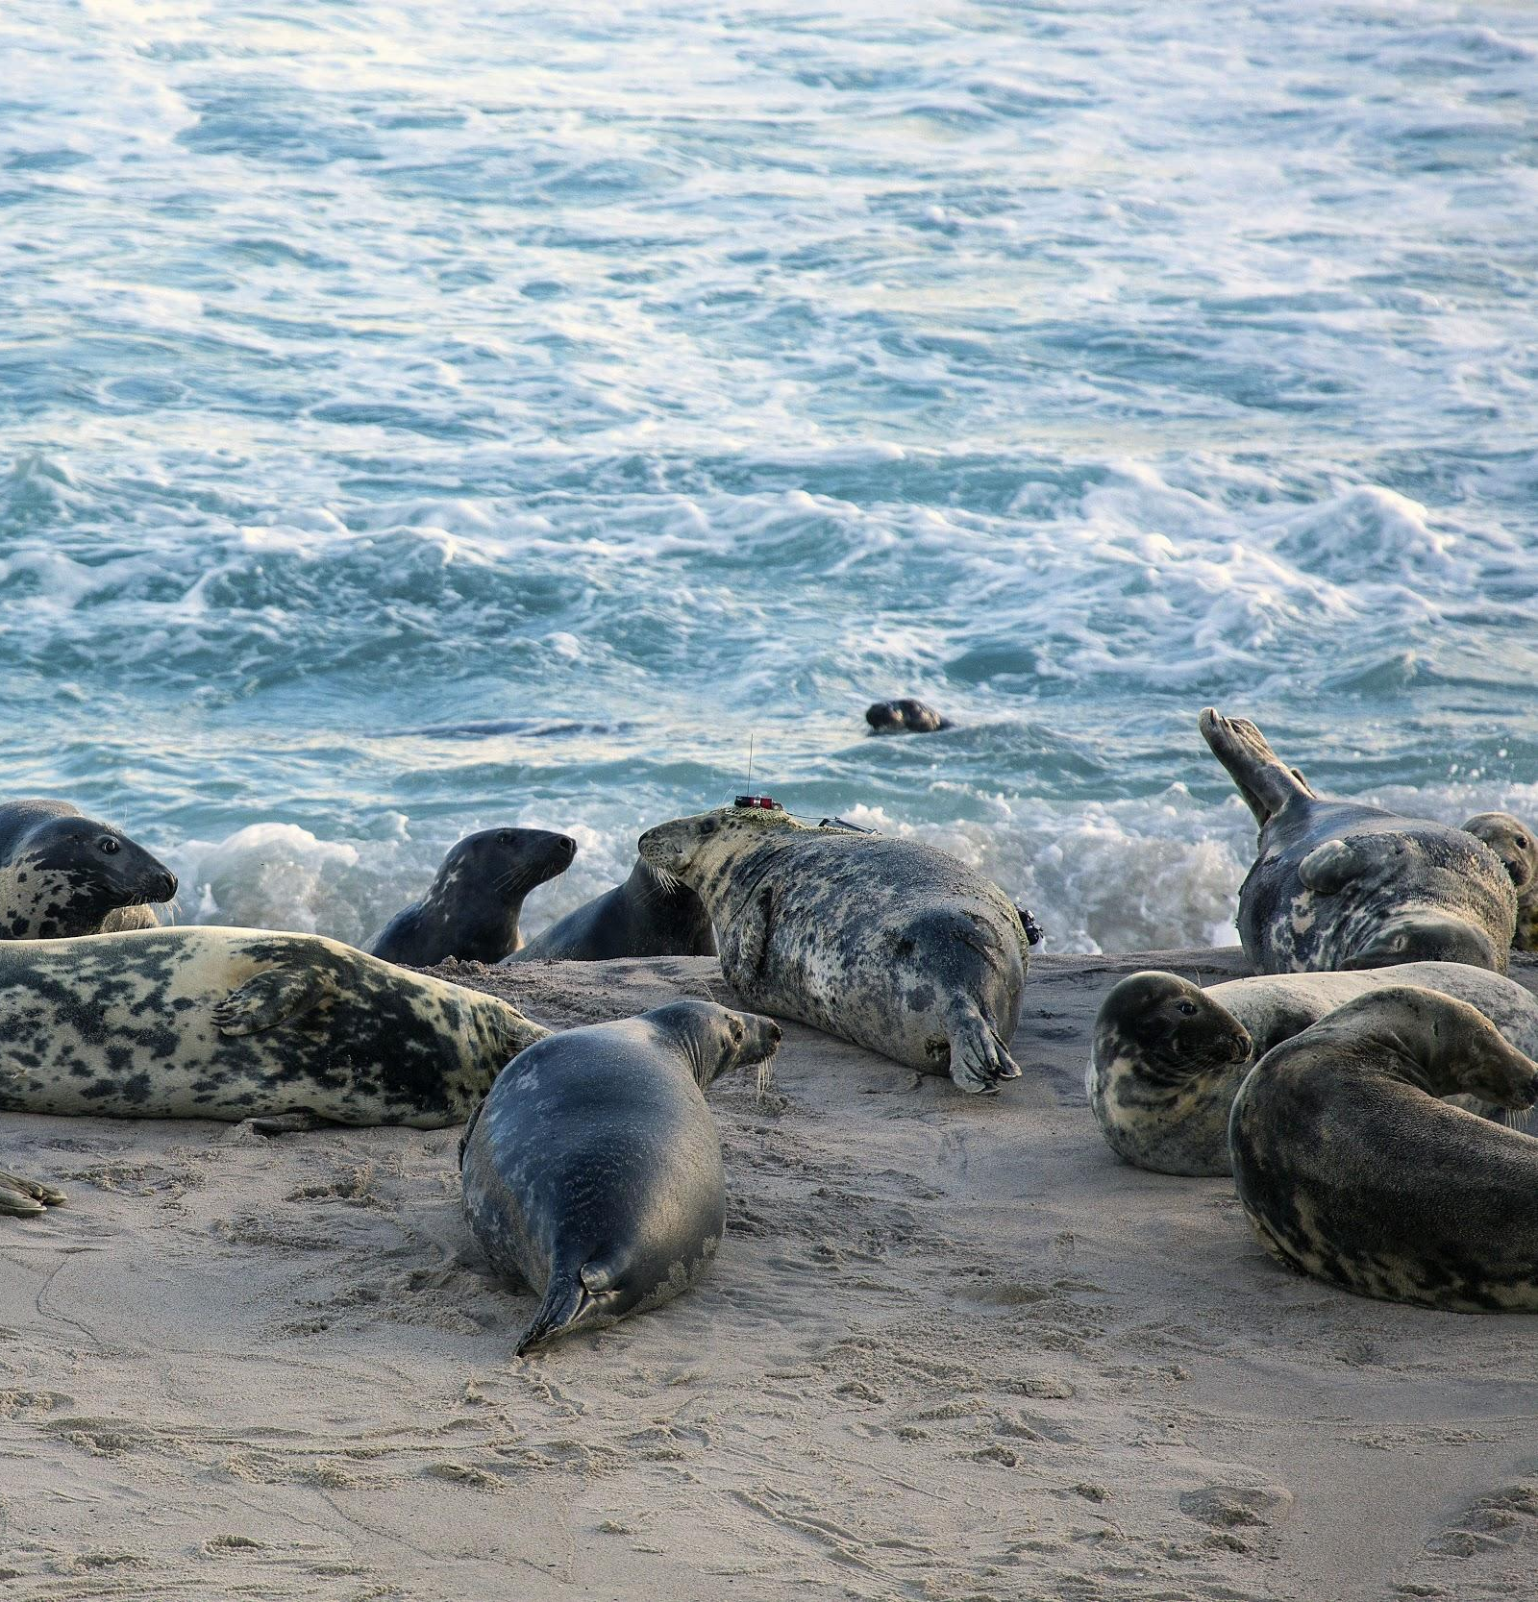
Workshop Schedule
Day 3
Publishing your datasets to OBIS via OBIS Canada
Submitting / updating DarwinCore archives to OBIS Canada
Contributing data to an OBIS Node
OBIS Guidelines on Data Sharing and Use
Motivations for sharing data
Licensing your dataset
Hands-on session 2: Mapping your own datasets into a parse-able DwC-A / EML package for OBIS-Canada
Day 4
Finding, collecting, visualizing and analyzing data from DwC archives from OBIS’s data portal or via robis
Contributing to OBIS and OBIS Canada as a collections manager or as a software developer
How to stay connected to OBIS-Canada
Feedback and Wrap-up
OCEAN TRACKING NETWORK
Notes:
The final day, we’ll take our experience and work out how we might implement something that will last a bit longer-term here at OGSL. We’ll decide what form that takes together, but some ideas I had were, designing a data pipeline that produces, from your current data workflows, an OBIS compliant archive for a given biodiversity project held here at OGSL. We could alternatively (or we can do multiple groups if there’s a few things we want to tackle) put up a test-mode IPT service so that you can verify and publish DwC archives yourselves. We could also help bridge the gap between Python and R users of OBIS and rescue pyobis, or design ourselves a replacement that will give people access to the OBIS and WoRMS APIs in the way that they are used to seeing in the R packages that OBIS offers. If there’s a project idea you have at the end of the instruction period, we can get a start on scoping it on day 3, and see how far we can get started with it.

Slide 34
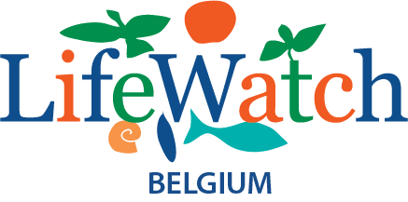

Introduction to WoRMS,
the World Register of Marine Species
Notes:
So the walkthrough of the WoRMS system was prepared by the inimitable Leen Vandepitte, I’ll do my best to hit all the same important points.

Slide 35

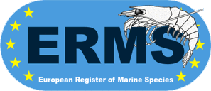
WoRMS in a nutshell
WoRMS aims to provide the most authoritative list of names of all marine species globally, ever published
Not just a name-index, but expert-based taxonomic database
>400 taxonomic editors
Elected Steering Committee (SC) (12+1 members)
Data management team
Permanent host institute: VLIZ => “here to stay”
Web-based system, including web-services
International standards
Background
2004: MarBEF EU FP6 => online European Register of Marine Species - ERMS
2007: further development to World Register
Notes:
So the world register of Marine Species aims to be an authoritative lookup engine for all marine species ever published, globally. It relies on human expertise to curate the living, changing taxonomic classification system. Their steering committee is composed of a broad geographic and taxonomic cross-section of research data management professionals, and their data management team at VLIZ is strongly backed by that institution. I remember a time when you could only use their SOAP web service, but now they have a wonderful REST API that we’ll explore later on. They began as the European Register of Marine Species, and they expanded to become the World Register in 2007.

Slide 36
Aphia platform
Databases hosted at VLIZ
WoRMS
Polychaeta
Porifera
HAB
WRIMS
...
AfReMaS
CaRMS
...
WoRDSS
Cetacea
Hydrozoa
...
Thematic species databases
IRMNG*
Mollusca
Base
Isopoda
RAMS
ERMS
...
Regional species databases
FreshGen
Compositae
Global species databases
FishBase
AlgaeBase
...
Externally hosted
and managed
species databases
Turbellaria
Reptiles
Vandepitte et al., 2015
Notes:
Figure 2: WoRMS in the Aphia Platform and its component taxonomic databases
Leen wrote a paper on how the Aphia platform helps both the taxonomists who build it and the biodiversity informatics folks who leverage it in the way we’re about to see.
There are many databases that feed into the same Aphia platform. These data systems have different scopes, the blue ones are focused on the marine environment, the orange ones span all environments, marine/fresh/terrestrial, the yellow is a species database just for freshwater, and the green which is still a bit blue on this graph is a focus on terrestrial only.
Blue: species database with focus on marine environment;
Orange: species database dealing with all environments (marine-fresh-terrestrial);
Yellow: species database with focus on freswhater environment;
Green: species database with focus on terrestrial environment.
WoRMS: World Register of Marine Species;
IRMNG: Interim Register for Marine and Non-marine Genera;
AfReMaS: African Register of Marine Species;
CaRMS: Canadian Register of Marine Species;
RAMS: Register of Antarctic Marine Species;
ERMS: European Register of Marine Species;
HAB: IOC-UNESCO Taxonomic Reference List of Harmful Micro Algae;
WRIMS: World Register of Introduced Marine Species;
WoRDSS: World Register of Deep-Sea Species.
*: IRMNG is focused on genera, not species.

Slide 37
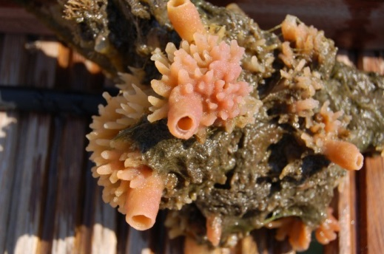

Databases hosted at VLIZ
Aphia
Haliclona (Soestella) xena
Introduced
WoRMS
HAB
Mollusca
Base
...
WoRDSS
Thematic species databases
Porifera
Polychaeta
CaRMS
Cetacea
...
AfReMaS
Hydrozoa
ERMS
Global species databases
RAMS
...
Regional species databases
WoRMS structure
An example…
Notes:
So in this representation, you can see that via a species’ AphiaID, you can find it in the global species databases that are appropriate, as well as the regional and thematic data systems, it goes into the Aphia database once, and based on its characteristics, it gets contexts in all the relevant data systems. This is a european invasive marine sponge species, and you can find it in the Worms database, the European register of marine species, in the IOC HAB data system under their subsection on foreign introduced species, and the global species-based database it belongs to, Porifera.
Identical to previous slide, but with an example to illustrate the fact that a name only gets added once into the Aphia database and – based on its characteristics: taxonomical, geographical or other – it gets a specific context (or contexts) and can be shown in several of the available species registers.
Haliclona (Soestella) xena De Weerdt, 1986 => marine sponge species, alien & european

Slide 38
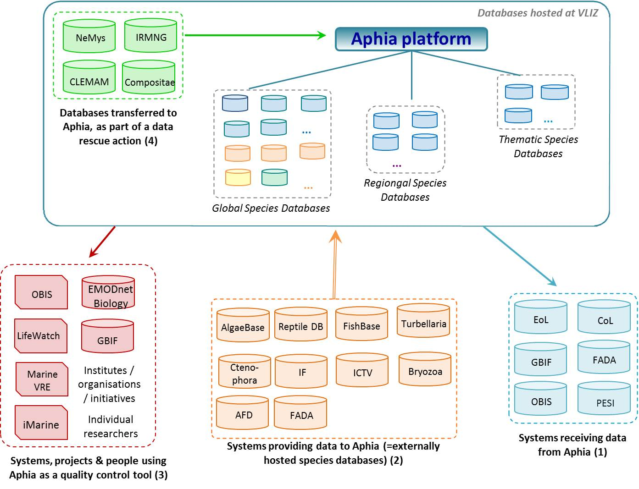
Relationship of Aphia with other systems & projects
Source: Vandepitte et al. (2015). How Aphia – the platform behind several online and taxonomically oriented databases – can serve both the taxonomic community and the field of biodiversity informatics. JMSE.
Notes:
There are a few ways Aphia relates to other data systems, and they fall into four broad categories can be identified:
Aphia as a data supplier to other systems,
Aphia as an integrator of relevant data from other systems,
Aphia as a quality control tool for the (taxonomic) content of other systems, projects and initiatives or
Aphia as an infrastructure to host and rescue databases at the risk of being lost.
NeMys: World List of Free-living Marine Nematodes;
IRMNG: Interim Register for Marine & Non-marine Genera;
CLEMAM: Checklist of European Marine Molluscs;
Compositae: Global Compositae Checklist;
OBIS: Ocean Biogeographic Information System;
EurOBIS: European node of OBIS;
Marine VRE: Marine Virtual Research Environment;
GBIF: Global Biodiversity Information Facility;
Turbellaria: Turbellarian Taxonomic Database;
Ctenophora: Phylum Ctenophora: list of all valid species names;
IF: Index Fungorum;
ICTV: International Committee on Taxonomy of Viruses;
Bryozoa: Recent & Fossil Bryozoa;
AFD: Australian Faunal Directory;
FADA: Freshwater Animal Diversity Assessment;
EoL: Encyclopedia of Life;
CoL: Catalogue of Life;
PESI: Pan-European Species directories Infrastructure;
OToL: Open Tree of Life.

Slide 39
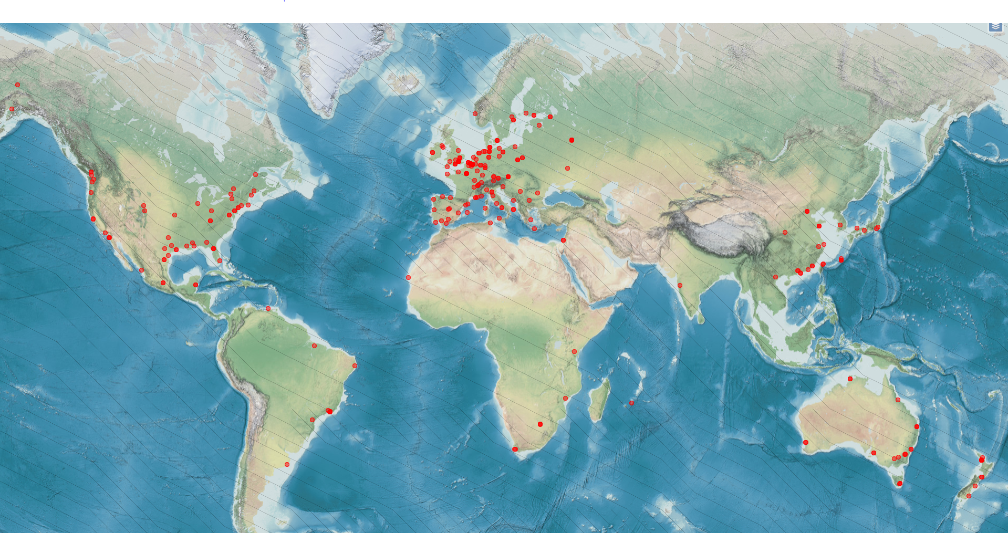
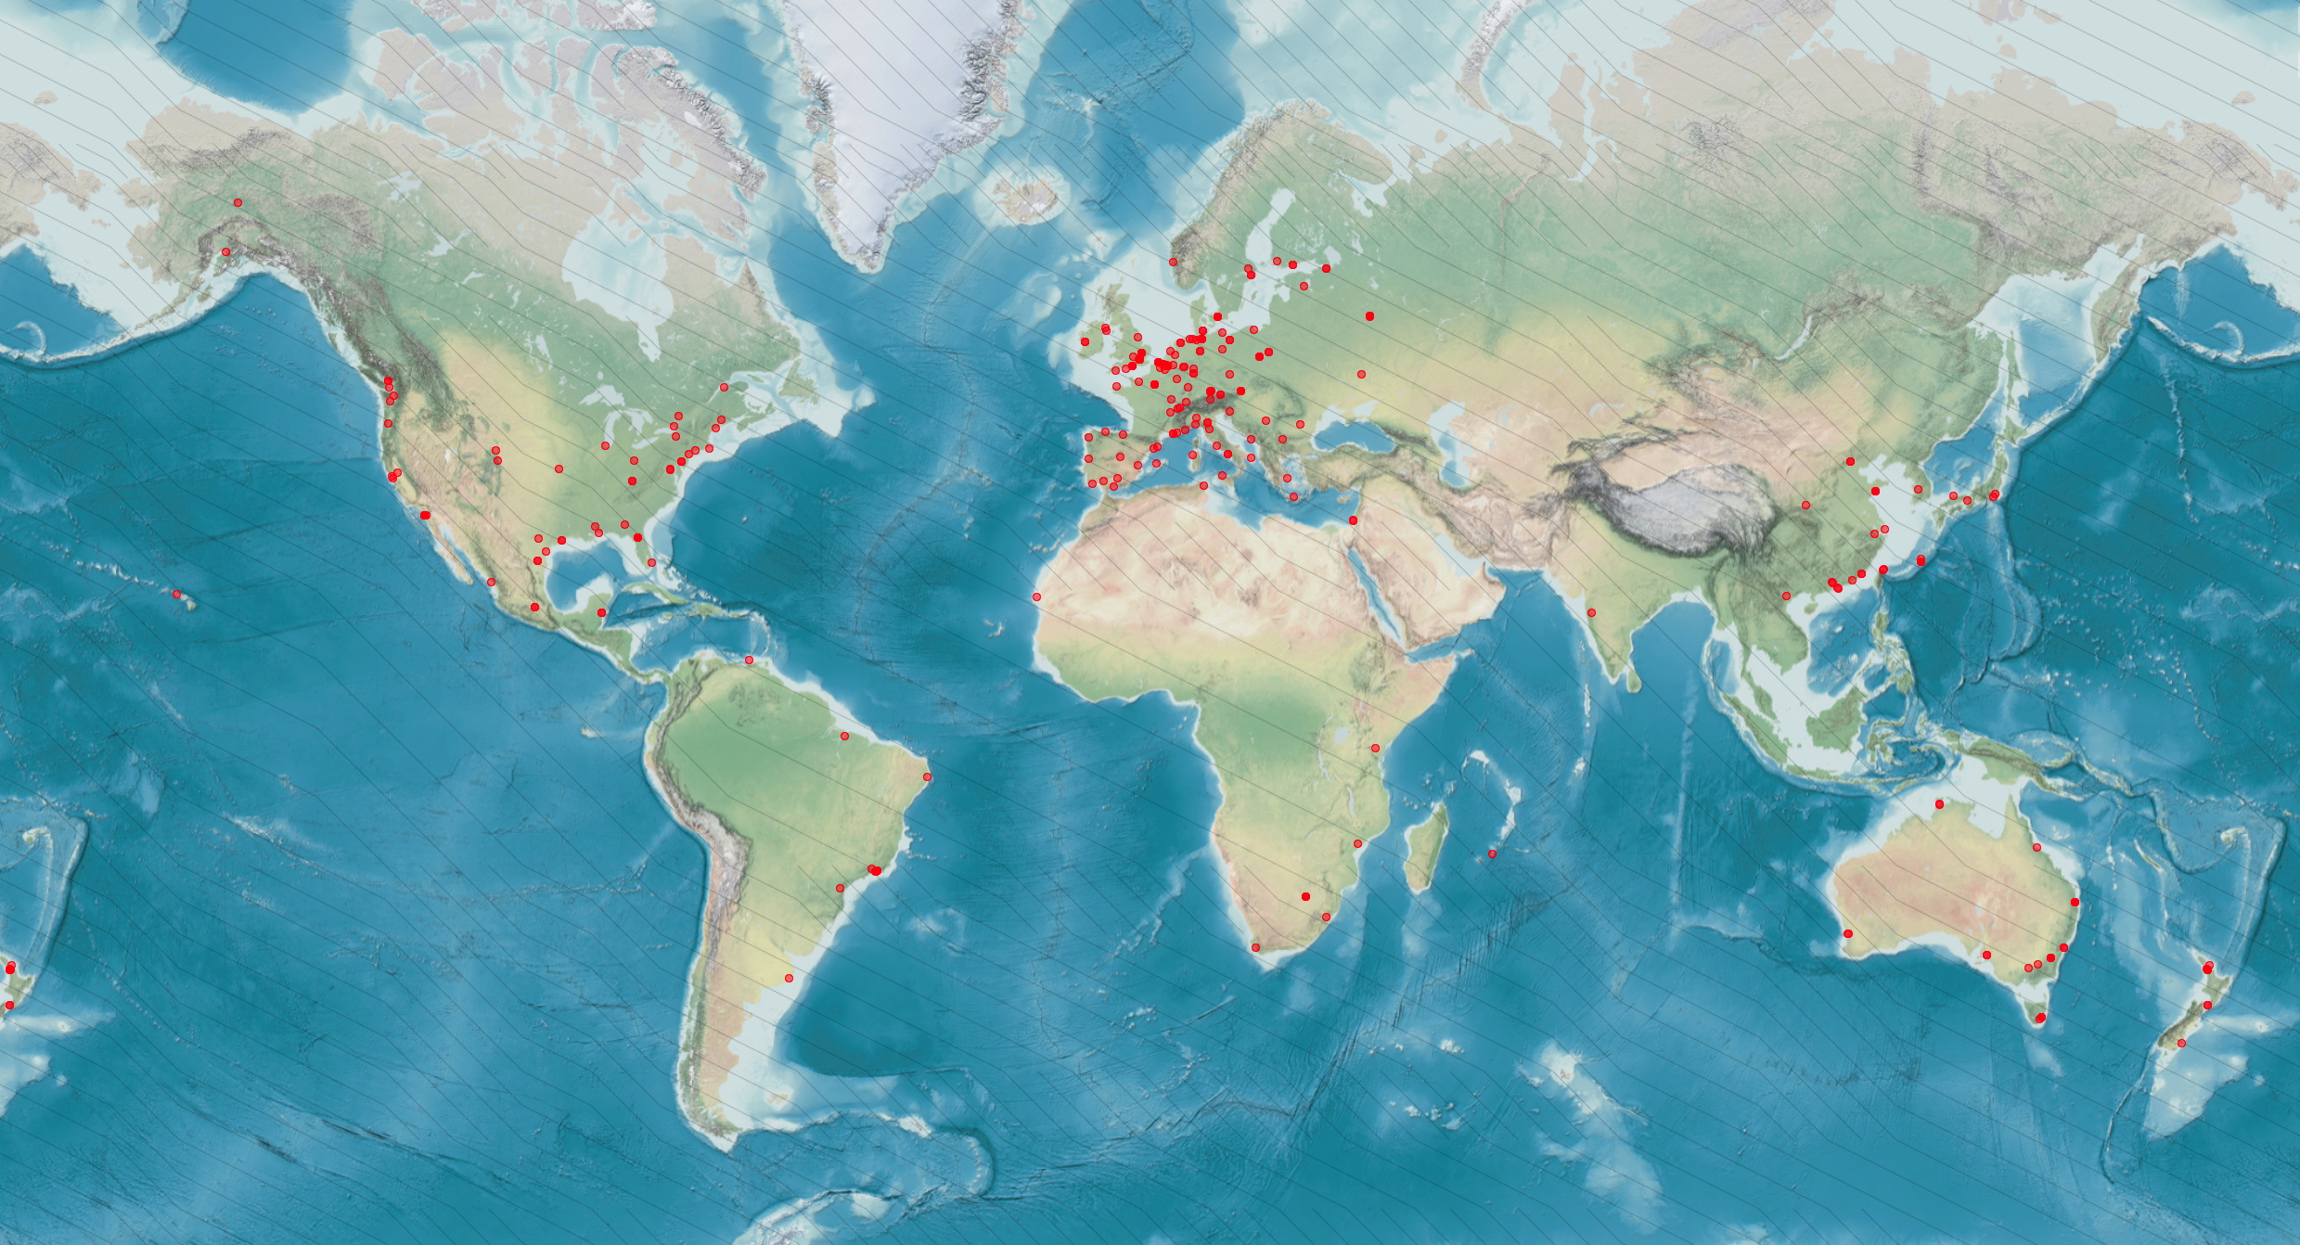
WoRMS – supported by a large editorial network
Taxonomic & thematic editors
> 400 people > 40 countries > 190 institutes
Notes:
WoRMS has a great international reach, supported by 400 taxonomic experts across 40 countries and 190 institutes, including Curtis Suttle and Evgeny Pakhomov over at UBC’s Earth, Ocean and Atmospheric Sciences department, who are taxonomic experts in viruses and antarctic marine species, respectively.
An updated map can be retrieved from http://www.marinespecies.org/map.php?type=te

Slide 40
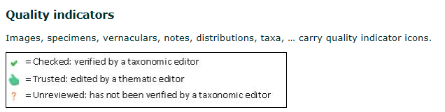
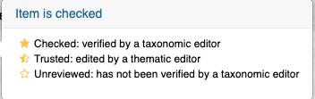
WoRMS management
Different levels…
WoRMS Steering Committee
WoRMS editors
Taxonomic editors
Thematic editors
Data management team
Editorial actions :
“checked” (from editor or global species database)
“Trusted” (from regional or thematic species database)
“unreviewed” (from other sources)
Notes:
So from Steering Committee to editors to the data management team that handles the availability and reliability of the data itself, there’s a lot of pieces that go into making sure the data we ask WoRMS for comes back to us in a way we can use it. Editors can attach quality indicators to images, specimens, vernaculars, even whole taxonomic entries. So when you see it’s checked, that means an editor has seen it and verified it. Trusted means a thematic editor, someone who specializes in this family or this taxa, has approved it, and if nobody’s reviewed it yet to sign off on it being 100% accurate, you will see Unreviewed. A submission was still made, meaning someone cared enough to add it, and almost always that meand they provided literature to back up their claim, but the editors haven’t looked it over yet.

Slide 41
WoRMS – content for a single entry
Aphia: a lot more than just taxon names & their relationship…
Feeding type
Host-parasite relations
Body size
Fossil range
Skeleton (calcareous or not)
Taxonomy
Distribution
Attributes
Specimen
Sources
Aphia
Vernacular names
Identification keys
Notes
Links
Images
Internal database management
Notes:
So there’s a lot more than just taxonomic names in WoRMS, you get regional vernaculars in many different languages, you get distribution data if such data has been submitted and verified, you get images if they’ve been submitted, you get other weirder attributes like host-parasite relationships and what sort of skeleton these creatures have. A lot of optionally-populated fields that can help you or more likely your data providers get a good verification regime going.

Slide 42
WoRMS – content for a single entry
Minimal
Species name - authority & publication year - higher classification
Environment
Status (recent – fossil – recent & fossil)
Highly desired
Basionym
Reference of original publication
Holotype information (type locality, museum collection, number …)
Optional
Additional syonyms, references, images, morphological description, distribution, ecological information (feeding type, host-parasite relation …), web links & pdfs
Notes:
At minimum, you can be assured you’ll find a species name, the year it was coined, the publication associated with its naming, and the classification tree. You’ll know which environments it can be found in, marine, brackish, freshwater, and you’ll get a status. WoRMS encourages people to provide a basionym, which I’m not afraid to say I had to look up the meaning of, it’s the original name on which the new name for a species is based. So you can trace the history of a species’ classification using the basionyms. a reference to the original naming publication, and a visual representation, images, ilustrations, classification sheets, etc.
And as we’ve seen, there’s a whole laundry list of other things they can and will accept about a species. Morphological description can be very useful for QC, the size ranges and weight ranges for different sex and lifestages of species is very handy information for people at OTN to have, for example.

Slide 43
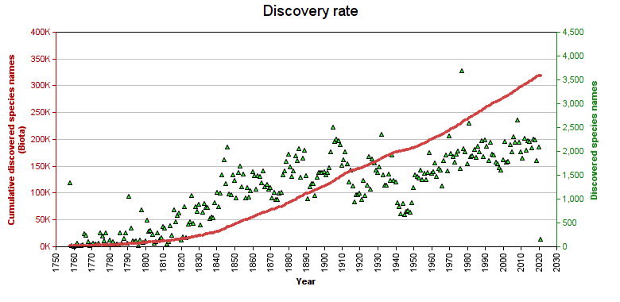
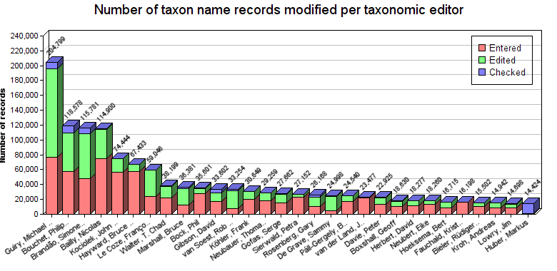
WoRMS – where are we? Some number crunching…
Taxonomy:
375,724 accepted marine and non-marine species; of which 96% is checked
566,028 species names including synonyms (marine & Recent)
9,420 citations or references to WoRMS in literature
Still a number of (historical) gaps to fill => work in progress
Increment of 1,500 - 2,000 newly described species per year
> 135,000 non-marine species (accepted + synonyms)
E.g. Mollusca, Isopoda, Plantae, Chromista
Notes:
Stats recap: read slide (update before presentation via http://www.marinespecies.org/aphia.php?p=stats
There’ll always be more to do, new species are discovered, described, updated, reclassified, and there is a high scores page for taxonomic editor contributions to the Registry. The work that these volunteers do is vital for those of us who depend upon WoRMS for our quality control, and there are many of us who do. As of 2017 there were:
Usage:
± 90,000 unique visitors per month
± 3 million hits per month
>150 registered users of our web services
> 80 institutes/organisations receive access to download a monthly copy of WoRMS
And in the years between then and now, the number of non-marine species being tracked here has tripled and the number of citations for WoRMS has gone from 1,500 to almost 10,000. Many of us depend on this taxonomic data system, and appreciate the time and effort you experts take to ensure accurate and timely information is being served.

Slide 44
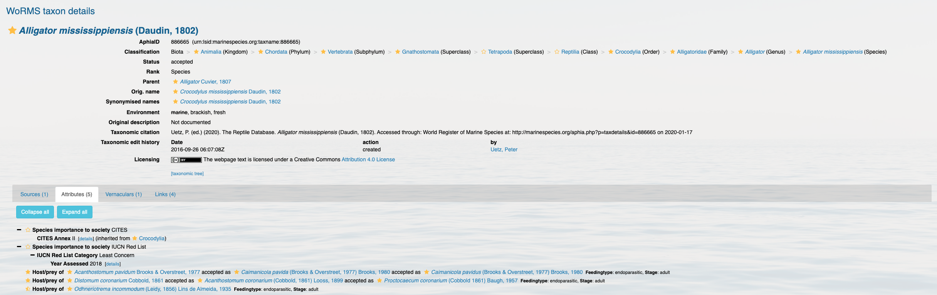
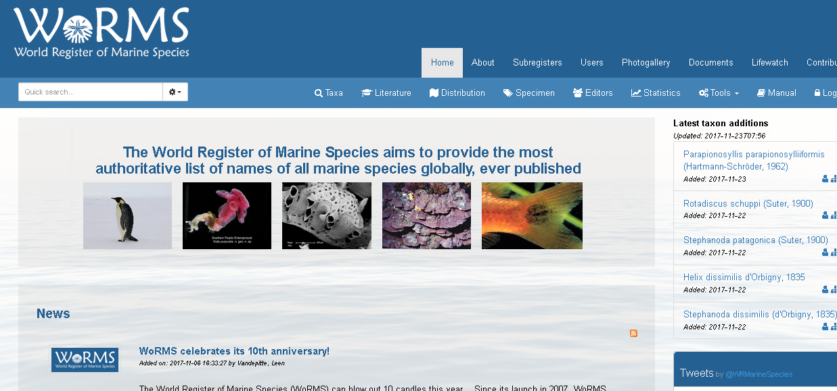
Online interface https://marinespecies.org
Notes:
So here’s what a species result page looks like on the WoRMS web-front, this is for something I bugged them to add back in 2016, when they were still considering whether they wanted to incorporate freshwater species. Its got fully confirmed taxonomic information, it’s got the history of its classification and synonyms, there are some attributes provided where you have host/prey species, two of these are checked/confirmed, and one of them is merely Trusted.
The result we get back from the WoRMS API will have verification statuses for a lot of these attributes and we can decide whether we want to be particular about what level of verification we require. For name verification, we don’t have to do much, but your application can differ.

Slide 45
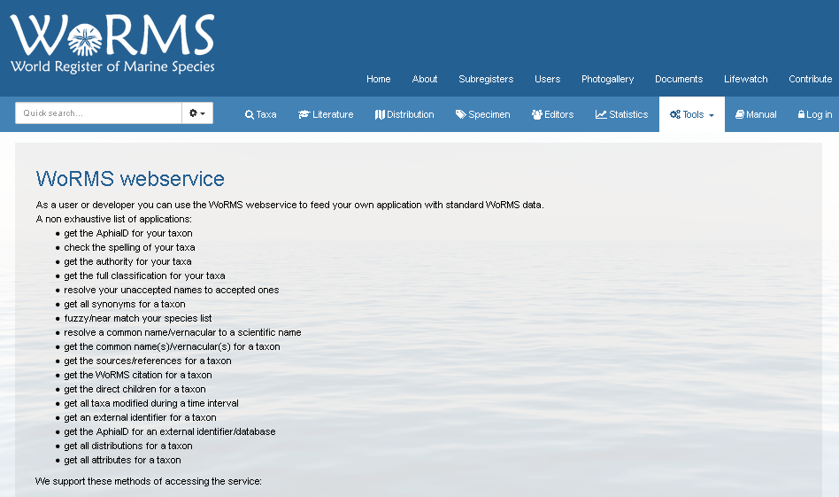
Web services: https://marinespecies.org/aphia.php?p=webservice
Notes:
And if you go to the Tools part of the WoRMS website you’ll see the various service endpoints they support. I’m proud/ashamed to say that my example implementation of how to use the SOAP service is still listed there, though I didn’t get to write the actual instructions for deploying it, I just gave them a file called worms.py that had functions with SOAP-py and SUDS implementations, and they wrapped it in command-line arguments and put it on there. Since then they’ve had a REST API stood up and we really do recommend going with that one. We’ll work with it later on to verify submitted taxonomic data.

Slide 46
WoRMS – part of LifeWatch
LifeWatch is part of the European Strategy Forum on Research Infrastructures (ESFRI)
LifeWatch = virtual laboratory for biodiversity research:
Biodiversity observatories, databases, web services and modelling tools
Integration of existing systems, upgrades, new systems
Construction phase: 2012 – 2016
Financed by Member States
Development of regional and central components by participating countries
Building a taxonomic backbone (focus on aquatic environment)
Building a Marine Virtual Research Environment (Marine VRE)
Start with “light” version => can become full grown infrastructure, conform reference model envisaged under LifeWatch
Based on existing data resources, web services, analysis services & tools
Notes:
Bottom-up development demonstrating possibilities
Construction of light version that can grow towards a full grown infrastructure conform reference model envisaged under LW
Building marine virtual research environment based on existing data resources, web services, analysis services and tools.

Slide 47


WoRMS – supported by LifeWatch
Taxonomic backbone
Facilitates the standardisation of species data
(Virtually) brings together different component databases & data systems
5 major components
SPECIES REGISTERS
Coordination:
Bring together existing databases; map their relationships; build web services
Complete & update taxonomic & species-related data
Data grants for editors
Data Management Team support
Technical developments
Organize & mobilize taxonomic experts
Organize workshops
Support meetings
Global
Thematic
Regional
National
LifeWatch Taxonomic Backbone
SPECIES OCCURENCES
LITERATURE
Global
Thematic
Regional
National
ECOLOGY (traits)
GENETICS
Notes:
The LifeWatch Taxonomic Backbone (TB) facilitates the standardisation of species data and the (virtual) integration of the many distributed biodiversity data repositories and operating facilities.
The TB (virtually) brings together different component databases and data systems, dealing with 5 major components:
Taxonomy: regional, national, European, global and thematic species registers
Biogeography: databases dealing with species occurrences
Ecology: species-specific traits
Genetics
Literature: links to available literature and tools to intelligently search this literature
The first level aims at setting up a central taxonomic backbone by integrating the existing taxonomic, biogeographical, ecological, genomic and literature databases as contributing components and build access services bringing the data to the LifeWatch infrastructure.
The second level aims at completing and updating the taxonomic and species related data in the different component databases by supporting these communities with a central data management task force, which is providing technical, logistic and financial support for upgrading and expanding the component databases. An example are the LifeWatch data grants (link is external) that were written out to fill the gaps in information in the World Register of Marine Species (WoRMS).
The third level aims at organizing and mobilizing the taxonomic experts that provide the data by supporting the taxonomy societies in which they participate (e.g. TDWG (link is external), PESI (link is external), EDIT (link is external) and MARBEF+ (link is external)). LifeWatch will provide logistic and financial support for workshops and meetings with and between the societies.

Slide 48
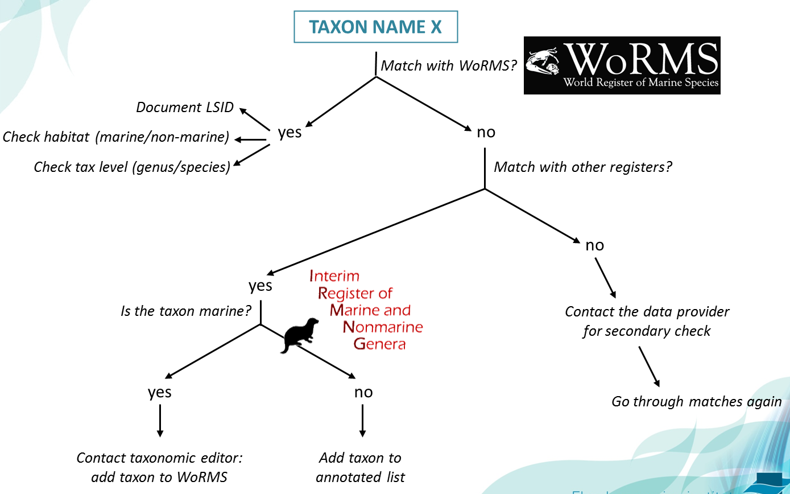
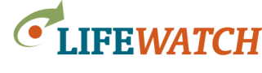
WoRMS – taxonomic backbone for OBIS
All OBIS taxon names are being matched against WoRMS
If no match is found in WoRMS, additional databases are consulted and – if necessary – the WoRMS editors are contacted for help
Notes:
So how do OBIS and WoRMS intermingle?
OBIS relies on WoRMS for verification of taxonomic data, and if matches can’t be found, they work with WoRMS editors to ensure that the gaps are filled

Slide 49
December 2012: ± 35,000 scientific names not matched to WoRMS
All names taken through matching process of previous slide
Notes:
So in 2015, when this slide deck was new, they were in the process of matching everything in OBIS with a real WoRMS entry. I don’t have the numbers now, but it’s mostly complete. everything that OTN adds has been verified in WoRMS, and it’s not to hard to verify your taxonomy against some part of the Aphia network, even the parts that aren’t WoRMS.
WoRMS editor(s) currently processing the names
WoRMS DMT working on update (e.g. AlgaeBase)
No WoRMS editor available for this group, so no way of verifying/correcting the name
WoRMS complete nonsense and needs to be sent back to the original provider for additional check

Slide 50
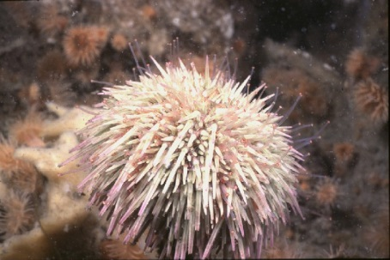
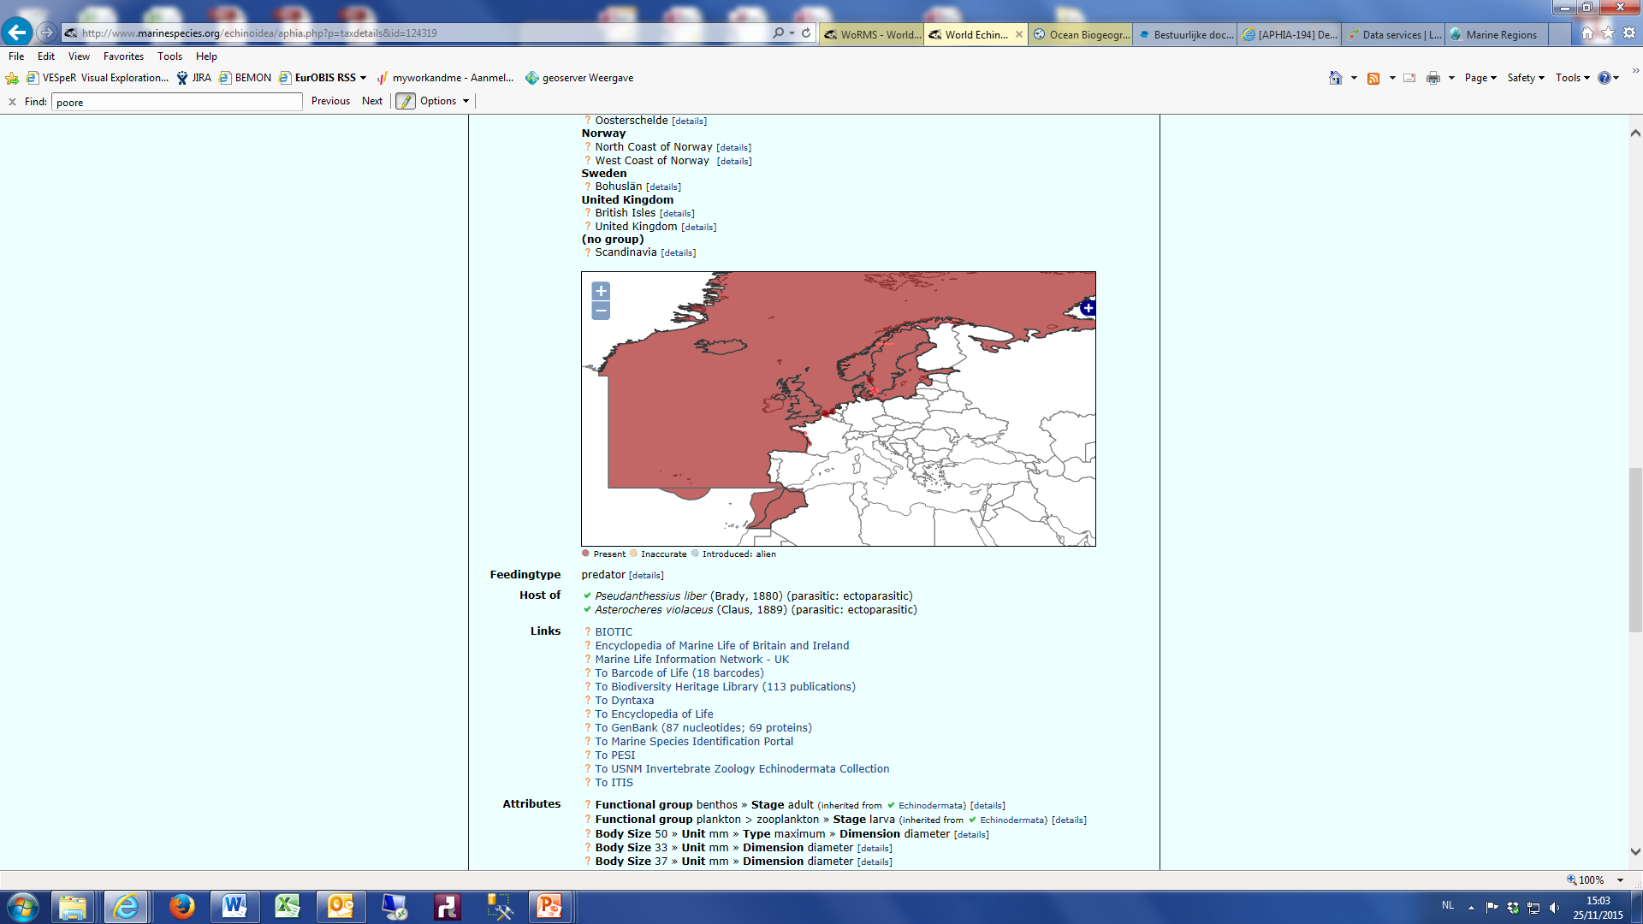
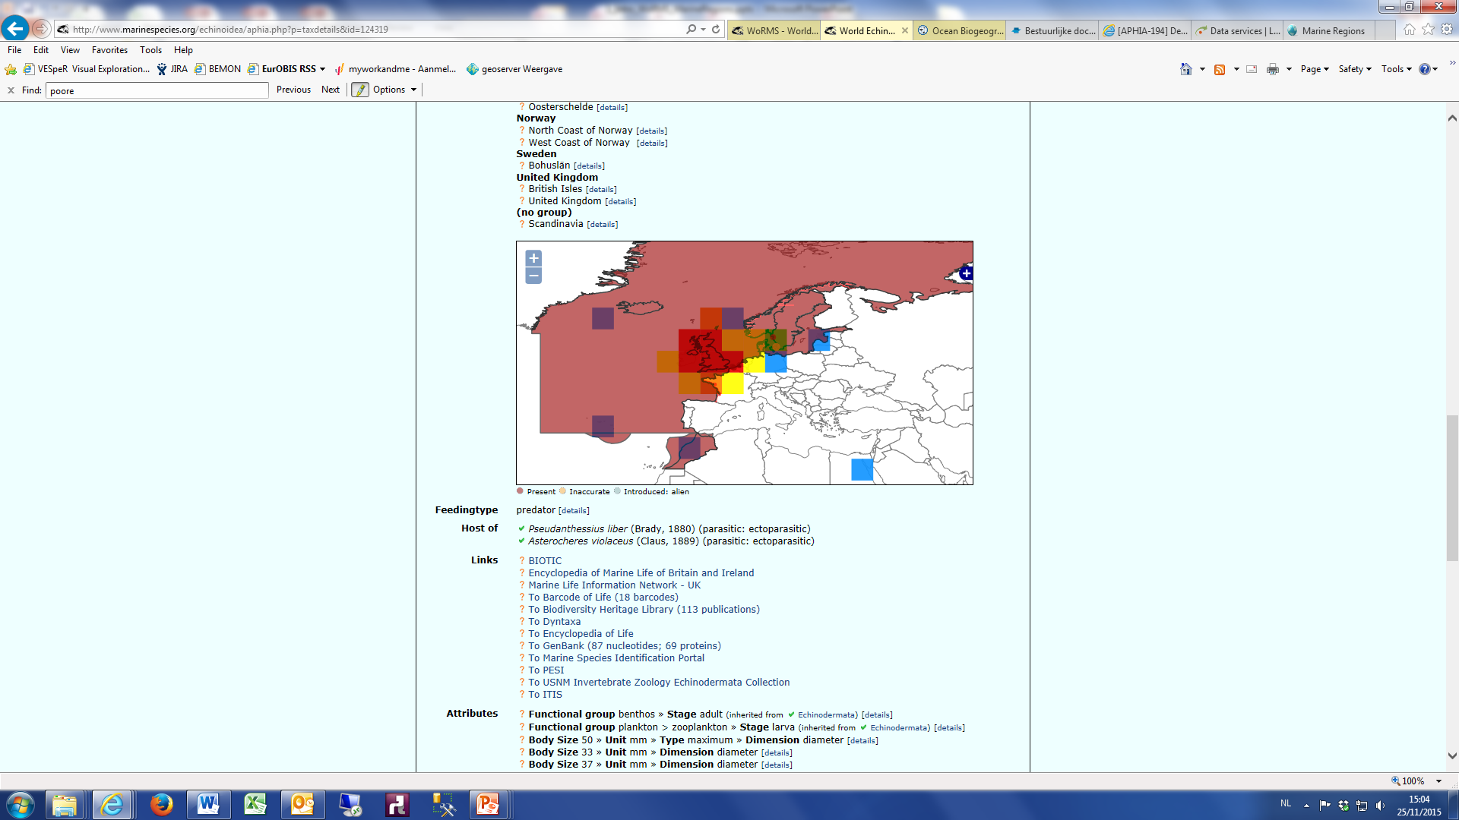
WoRMS – OBIS: mutual geographical quality control
Echinoidea example – Psammechinus miliaris
Needs checking in OBIS …
Notes:
A benefit of that harmonization is that both WoRMS and OBIS gain the geographical backstop that can be used to identify outliers in reported geography, and this sort of aggregation and comparison can run both ways.

Slide 51
Questions?
Read more:
Vandepitte, L.; Vanhoorne, B.; Decock, W. et al. (2015). How Aphia – the platform behind several online and taxonomically oriented databases – can serve both the taxonomic community and the field of biodiversity informatics. JMSE.
Costello, M.J.; Bouchet, P.; Boxshall, G. et al. (2013). Global coordination and standardisation in marine biodiversity through the World Register of Marine Species (WoRMS) and related databases. PLoS One 8(1): 20 pp. hdl.handle.net/10.1371/journal.pone.0051629
Appeltans, W.; Ahyong, S.T.; Anderson, G. et al. (2012). The magnitude of global marine species diversity. Curr. Biol. 22(23): 14 pp + suppl. inf (91 pp.). hdl.handle.net/10.1016/j.cub.2012.09.036
Notes:
So that’s the background on WoRMS. It can be an important step in a good QA/QC process

Slide 52
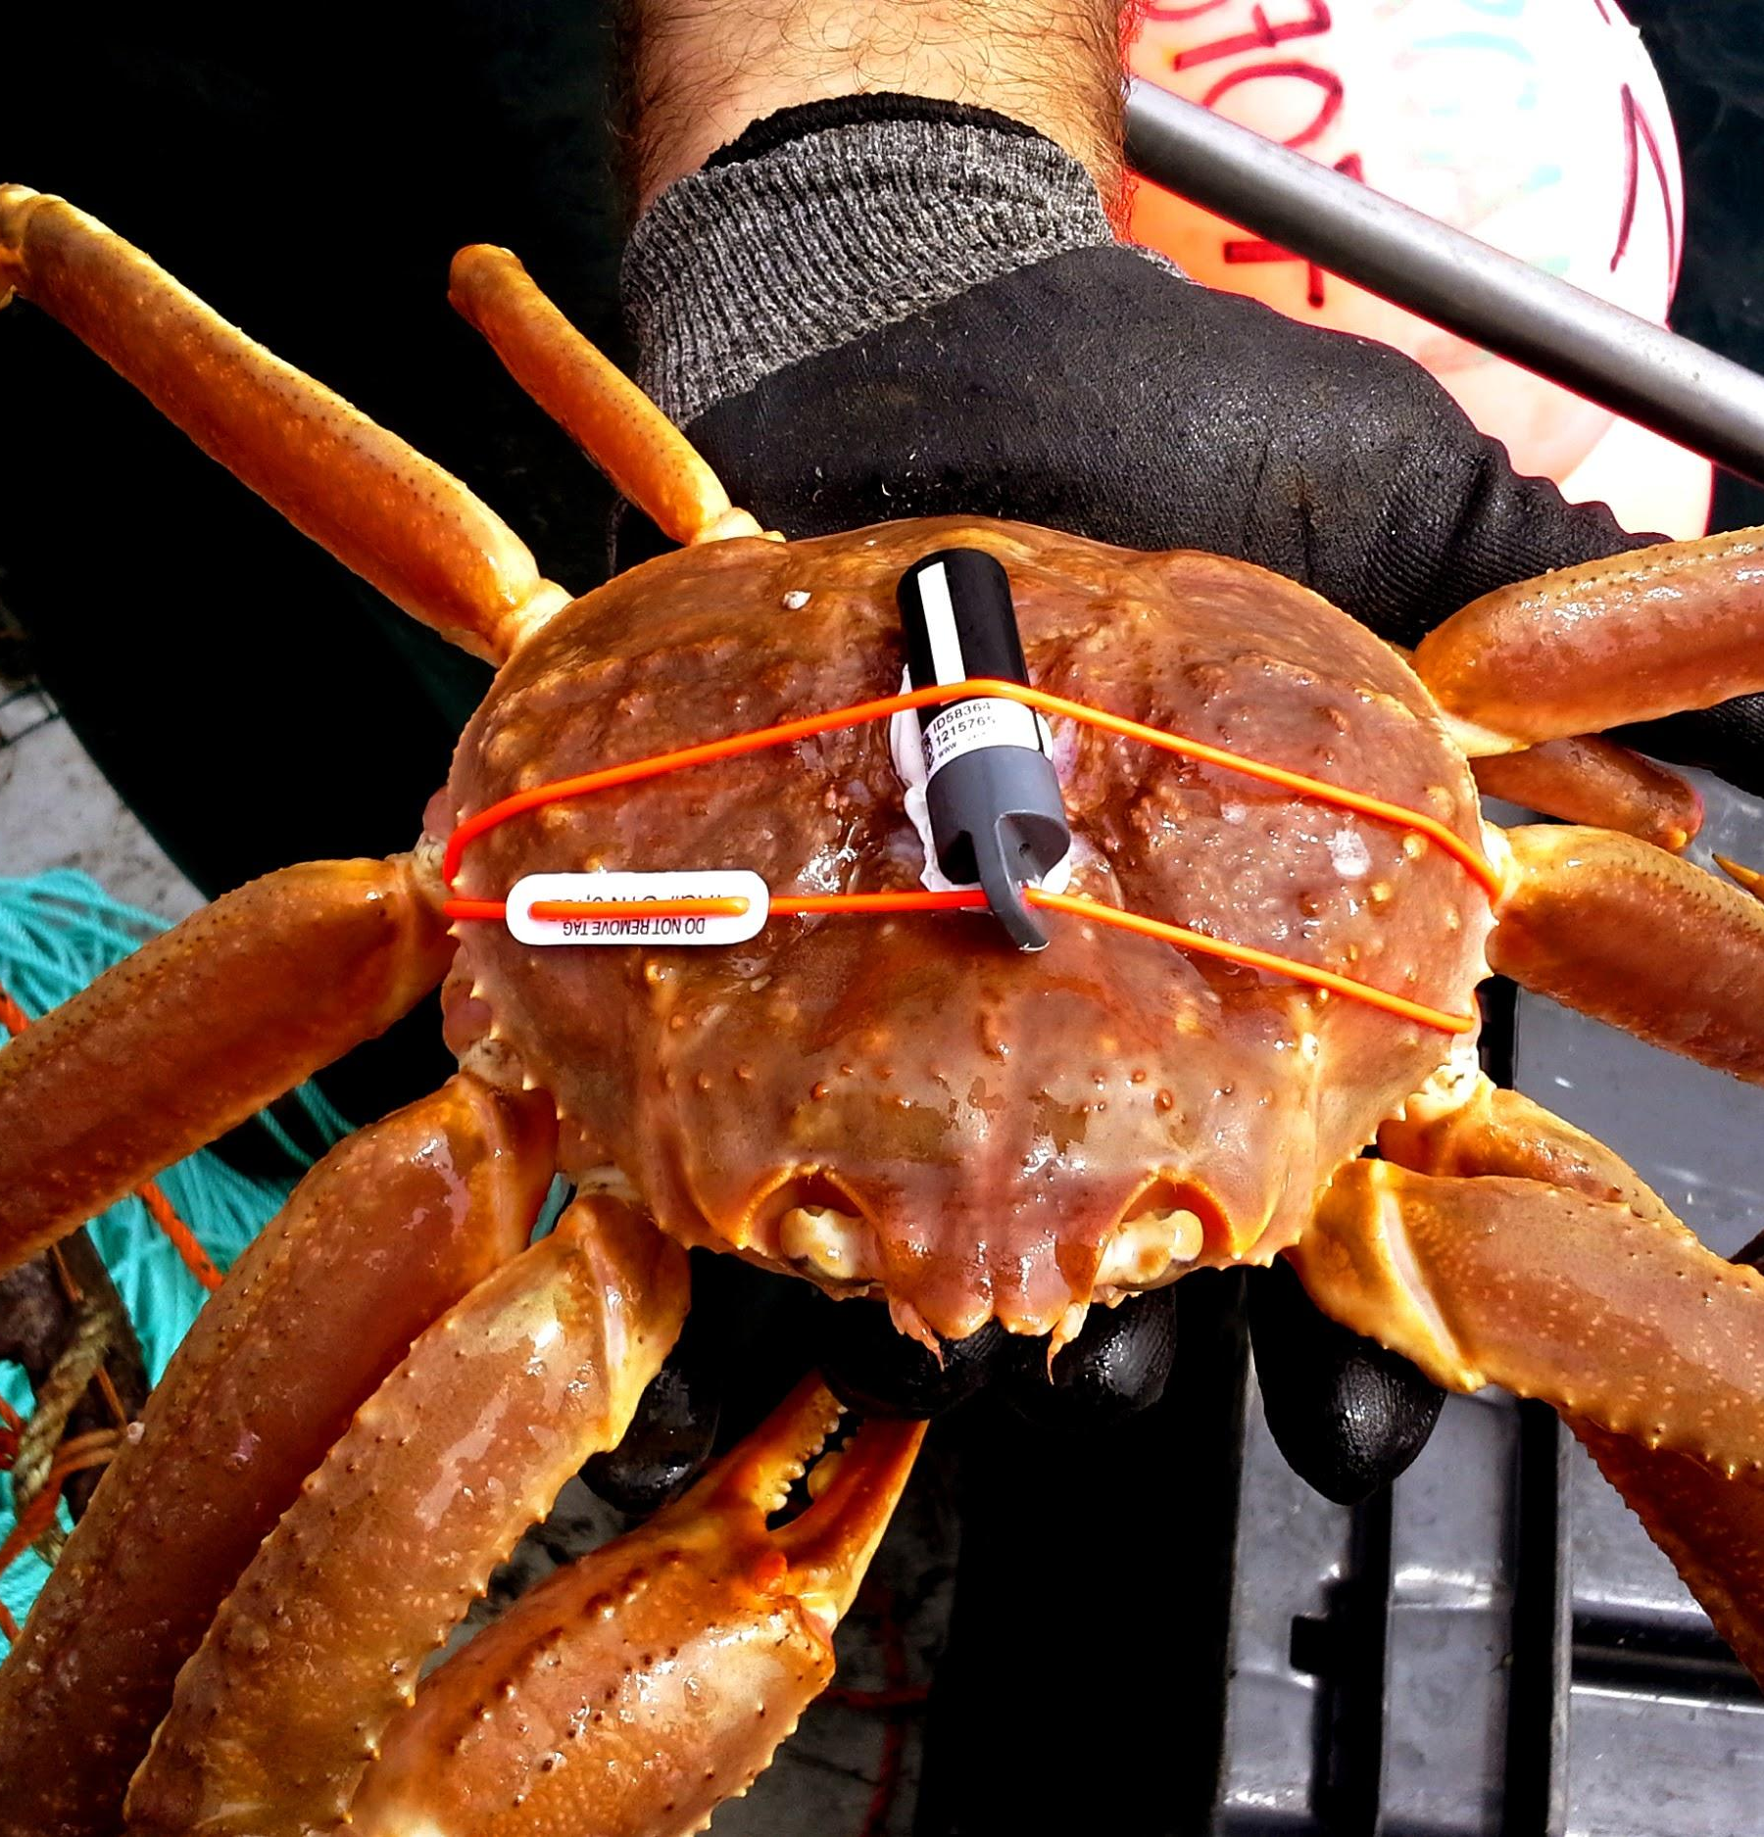
AQUATIC ANIMALS
Highly valued aquatic resources in a rapidly changing environment
Global food security
Billions of dollars per year in socioeconomic benefits
Structure healthy ecosystems and their resilience
Biological Essential Ocean Variables (GOOS)
Are culturally and globally significant
OCEAN TRACKING NETWORK

Slide 53
TAG TECHNOLOGY
Acoustic tags, satellite tags and data loggers
New tags have advanced the concept of mobile tracking to include large aquatic animals capable of documenting interactions with their surroundings, including environmental conditions and other tagged animals.
OCEAN TRACKING NETWORK

Slide 54

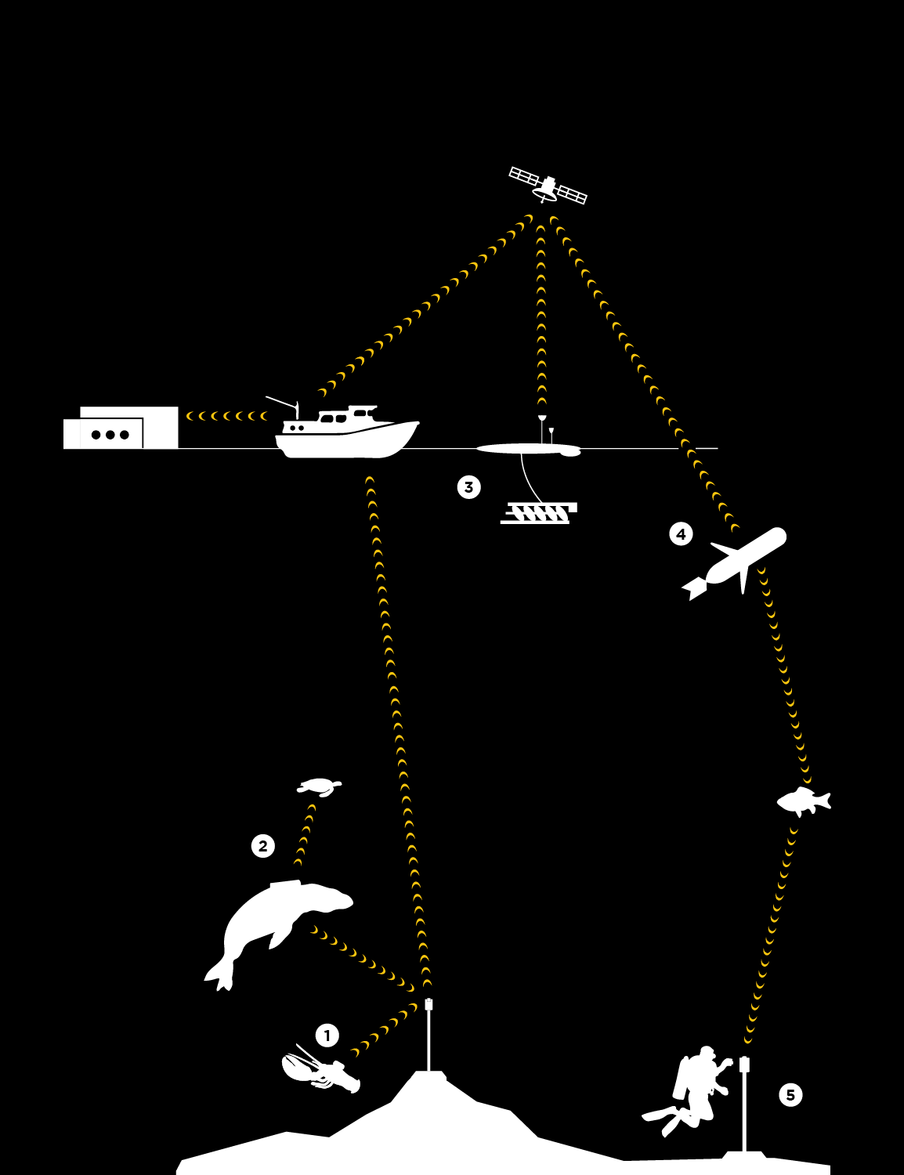
HOW TRACKING WORKS
Acoustic tags are small transmitters that allow researchers to track aquatic animals underwater.
Larger animals can carry Vemco Mobile Transceivers (VMTs), which act as both transmitters and receivers.
Wave Gliders float on the ocean’s surface. They are emission free, propelled by wave energy and solar powered.
Slocum Gliders dive up and down collecting information underneath the waves.
Acoustic receivers capture animal movement data.
OCEAN TRACKING NETWORK

Slide 55
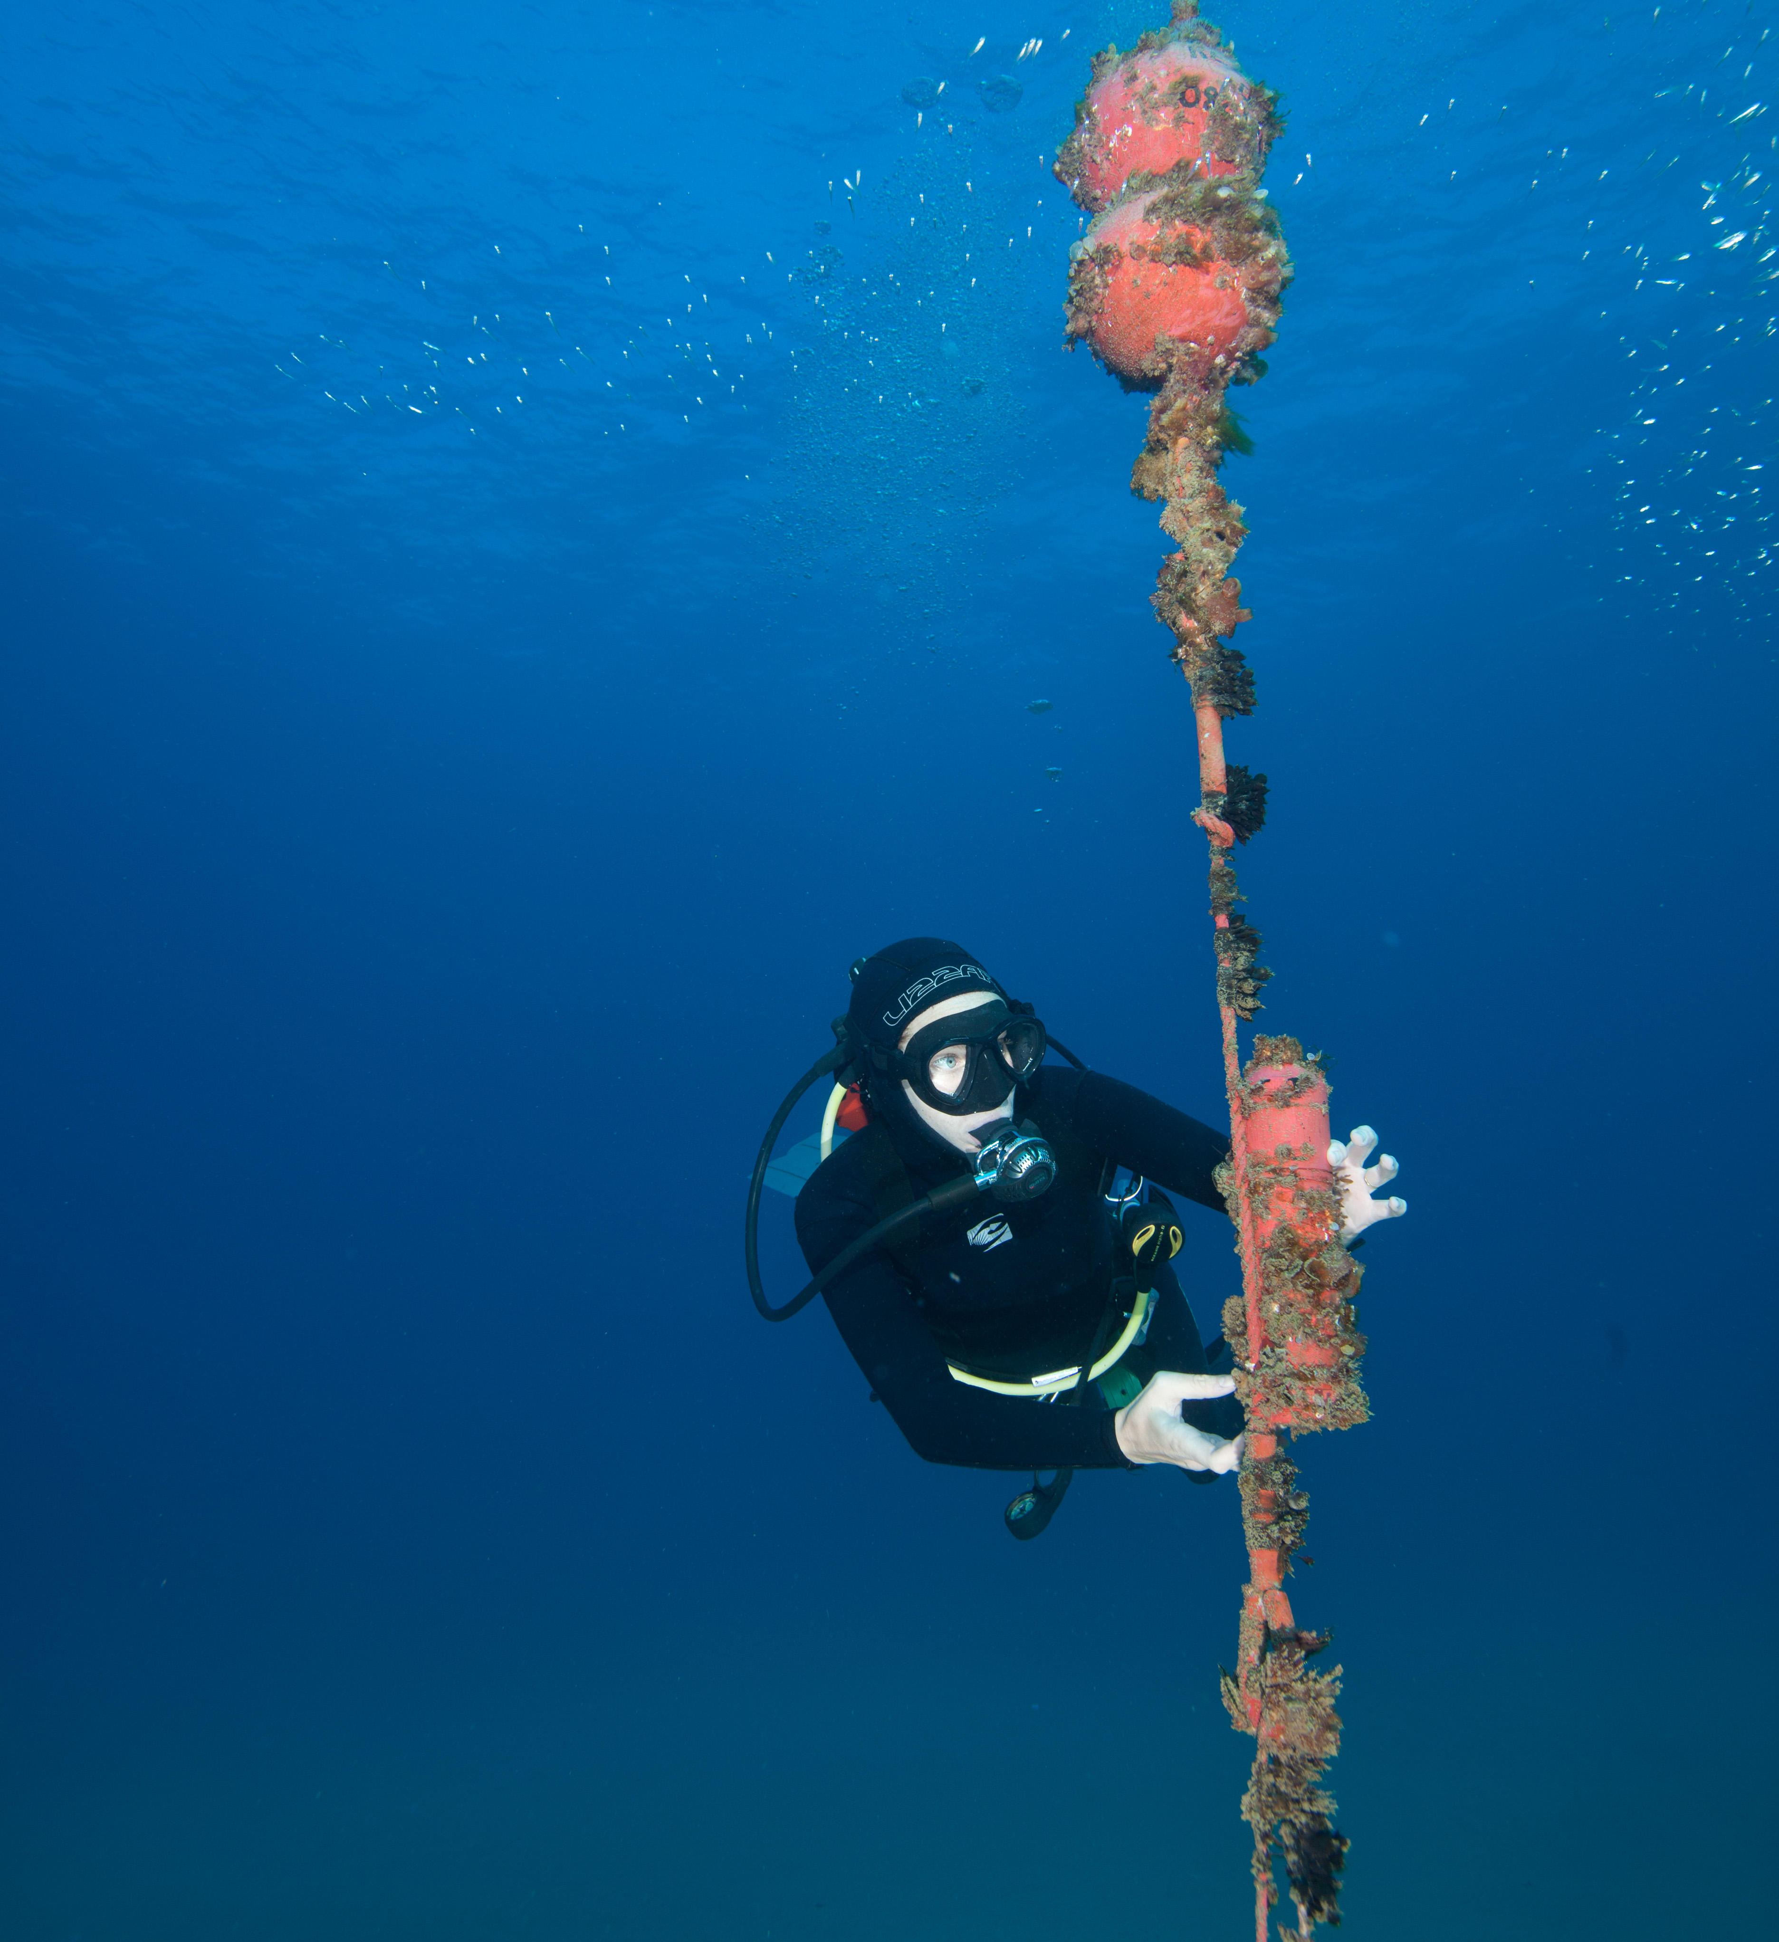
ACOUSTIC RECEIVER MOORINGS
Recovery timelines
Rollovers
Offloads
Bluetooth
Acoustic
OCEAN TRACKING NETWORK

Slide 56

GLIDERS
Changing the way we study the ocean
Emission-free, cost-effective, and autonomous
Remotely offloads fixed tracking stations
Provides oceanographic context and equipment to track animals
Doesn’t get sea sick!
Wave glider: wave driven, powered by solar energy
Slocum glider: buoyancy driven, powered by lithium battery
More than____ km travelled since…
OCEAN TRACKING NETWORK

Slide 57

ROV: REMOTELY OPERATED VEHICLE
Saab Seaeye Falcon
Depth Rating up to 300 metres
Alternative recovery method
Film footage
Other projects
OCEAN TRACKING NETWORK

Slide 58
TRACK, CONNECT, TRANSFORM
Together, OTN and its collaborators are tracking oceans, connecting people and transforming knowledge
TRACK Using electronic tags to track more than 225 keystone, commercially important and endangered species.
CONNECT Connecting infrastructure, communities, resources, researchers, policy-makers, industry, and other stakeholders at local and global scales
TRANSFORM Transforming our understanding of the oceans by developing global data standards and a paradigm of collaborative research and management.
OCEAN TRACKING NETWORK

Slide 59

TRACK
Mysterious migrations of American eels
American eels are one of the most endangered fishes in North America
Their story begins and (usually) ends in the Sargasso Sea
Migrate to inland waters for 10 to 25 years
Return to Sargasso Sea to spawn
Journey first tracked by OTN researchers; revealed two-phase migration
Understanding routes and migration cues will help with conservation planning
OCEAN TRACKING NETWORK

Slide 60

CONNECT
Underwater robots tracking right whales and their prey
Gliders listen for baleen whale calls off the Scotian Shelf and Gulf of St. Lawrence
Capture the abundance of whale prey: zooplankton
Partnership with Canadian Wildlife Federation & MEOPAR (WHaLE)
Understand migration routes and habitat use
Scientific basis to establish policy and protected habitats
Reduce accidental ship strikes and fishing gear entanglements
OCEAN TRACKING NETWORK

Slide 61

TRANSFORM
First Nations Fisheries
Most Pacific salmon migrate in to the open ocean only once in their lives
Return to natal spawning grounds
Heavily targeted by fisheries
OTN is generating movement data in partnership with DFO, Indigenous peoples, ENGOs & harvesters
Transforming fisheries management approaches
Boosting conservation of Pacific salmon in B.C.
OCEAN TRACKING NETWORK

Slide 62

INFORMING POLICY
Sustainable management of emerging fisheries
1960s: Inuit communities developed Greenland halibut fishery in northern Cumberland Sound, N.U.
Divided from international fishing waters in southern portion of the Sound
Halibut populations were thought to be distinct
OTN research showed fish were crossing north and south boundary on a seasonal basis
Management line has been moved to encompass entire Cumberland Sound
More sustainable for both the Greenland halibut population and the community
OCEAN TRACKING NETWORK

Slide 63

OTN IN NUMBERS
47,500
614
212
75,000
TAGGED ANIMALS TRACKED
SENIOR SCIENTISTS
SPECIES TRACKED
GLOBALLY
KM COVERED BY GLIDERS
OCEAN TRACKING NETWORK

Slide 64



@oceantrackingnetwork
@oceantracking
oceantrackingnetwork.org

